Slide 1
PTA Role in Elections, Candidate Forums, and Ballot Measures
May 30, 2012

Slide 2
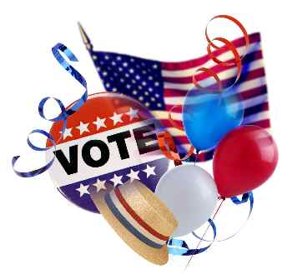
PTA: Role in Elections
★ Election Campaigns
★ Voter Registration
★ Candidate Forums
★ Candidate Questionnaires
★ Ballot Measures

Slide 3
PTA: Our Purpose
Promote the welfare of children and youth
Secure adequate laws for the care and
protection of children and youth

Slide 4
PTA: We Advocate and Lobby
ADVOCATE:
1. To plead in favor of, defend, support or urge by argument; recommend publicly.
2. One who pleads for, or on behalf of, another
LOBBY:
Influence legislation
and public officials

Slide 5
PTA: We Lobby
We lobby public officials to take positions
“Insubstantial part” of activity = 5%
We influence:
Educate and inform
parents and our communities

Slide 6
PTA: Organization Principles
California State PTA Bylaws Policy:
Noncommercial
Nonsectarian
Nonpartisan

Slide 7
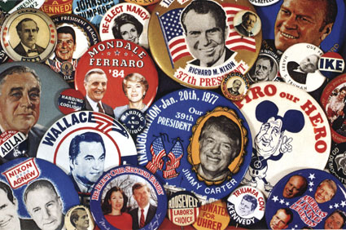
PTA: Organization Bylaws
“The organization or members in their official capacities shall not – directly or indirectly – participate or intervene (in any way, including the publishing or distribution of statements) in any political campaign on behalf of, or in opposition to any candidate for public office…”

Slide 8
PTA: Organization Bylaws
“…or devote more than an insubstantial part of its activities to attempting to influence legislation by propaganda or otherwise.”

Slide 9
PTA: Internal Revenue Service
“Exempt from Federal income tax under
Section 501 (c) (3)
of the Internal Revenue Code”

Slide 10
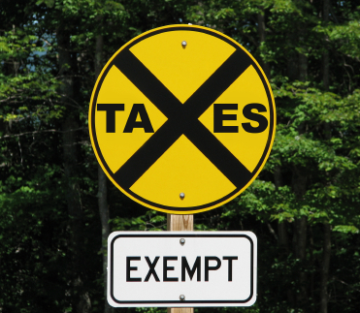
PTA: 501(c)3
Charitable
Tax-deductible contributions
File tax return
Not for private interest
Shun political activity
Limit lobbying

Slide 11
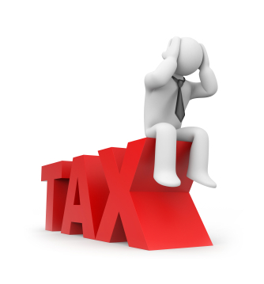
PTA: IRS Compliance
Failure to comply may endanger the 501 (c) (3) non-profit status of your:
Council
District
and STATE

Slide 12
PTA: Nonpartisan
Therefore, PTA does NOT:
Endorse or help any candidate or political party, including those running for school board or other nonpartisan offices
Invite only one candidate to speak at a meeting
Ask a candidate to sign a pledge
Distribute campaign materials at a
PTA event
Wear campaign paraphernalia at a
PTA event

Slide 13
PTA: Nonpartisan
Never use PTA resources
to support a political campaign

Slide 14
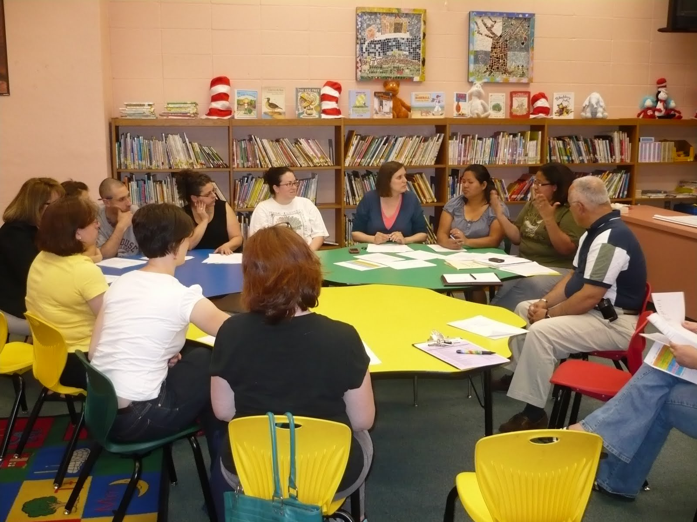
PTA: Nonpartisan
Leaders and members may…
Campaign as individuals
But not at a PTA event

Slide 15
PTA: Nonpartisan
California State PTA has higher standard than law:
Current PTA Officer/Board Member must not use PTA title, name of PTA, or trademark PTA
Supporters of Mike for Mayor:
Yes:
Susie Smith
NO:
Susie Smith, President, Harper Valley PTA

Slide 16
PTA: Role in Elections
We can:
Register voters
Host candidate forums
Develop & publish candidate questionnaires
Support or oppose ballot measures

Slide 17
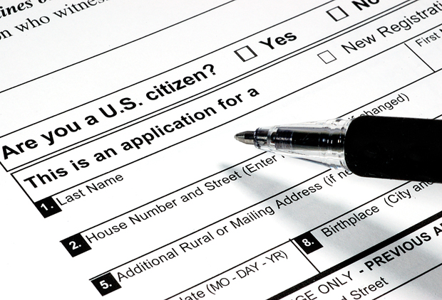
PTA: Registers Voters
Association approval of activity
Facilities Use Request
Registration forms
Two people at the table
Sign up new voters
Get out the vote! (GOTV)
Be nonpartisan
www.ocvote.com

Slide 18
PTA: Hosts Candidates Forums
Association approval of activity
Partner with another nonpartisan group
Centrally located facility/venue
Invite ALL candidates by certified mail and return receipt

Slide 19
PTA: Hosts Candidates Forums
Set rules and communicate to all
Find an impartial moderator
Use volunteers
Publicize
Conduct with civility and respect
Be nonpartisan

Slide 20
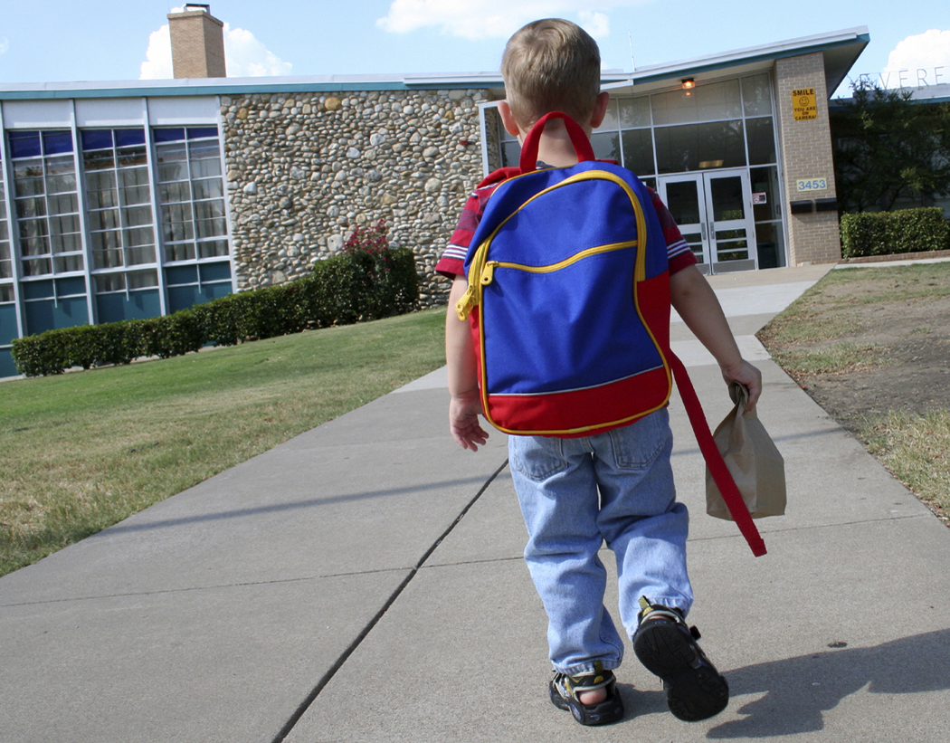
PTA: Hosts Candidates Forum
Questions for School Board Candidates:
What is your position on the value and importance of public education?
What are your top priorities for improving public education?
What are your priorities for reauthorizing ESEA?

Slide 21
PTA: Questions Candidates
Develop & publish a Candidates Questionnaire
Set word count and deadlines
Send to ALL candidates by certified mail and return receipt
Publish responses verbatim up to the word count limit
DO NOT EDIT responses
Note candidates who did not
respond

Slide 22
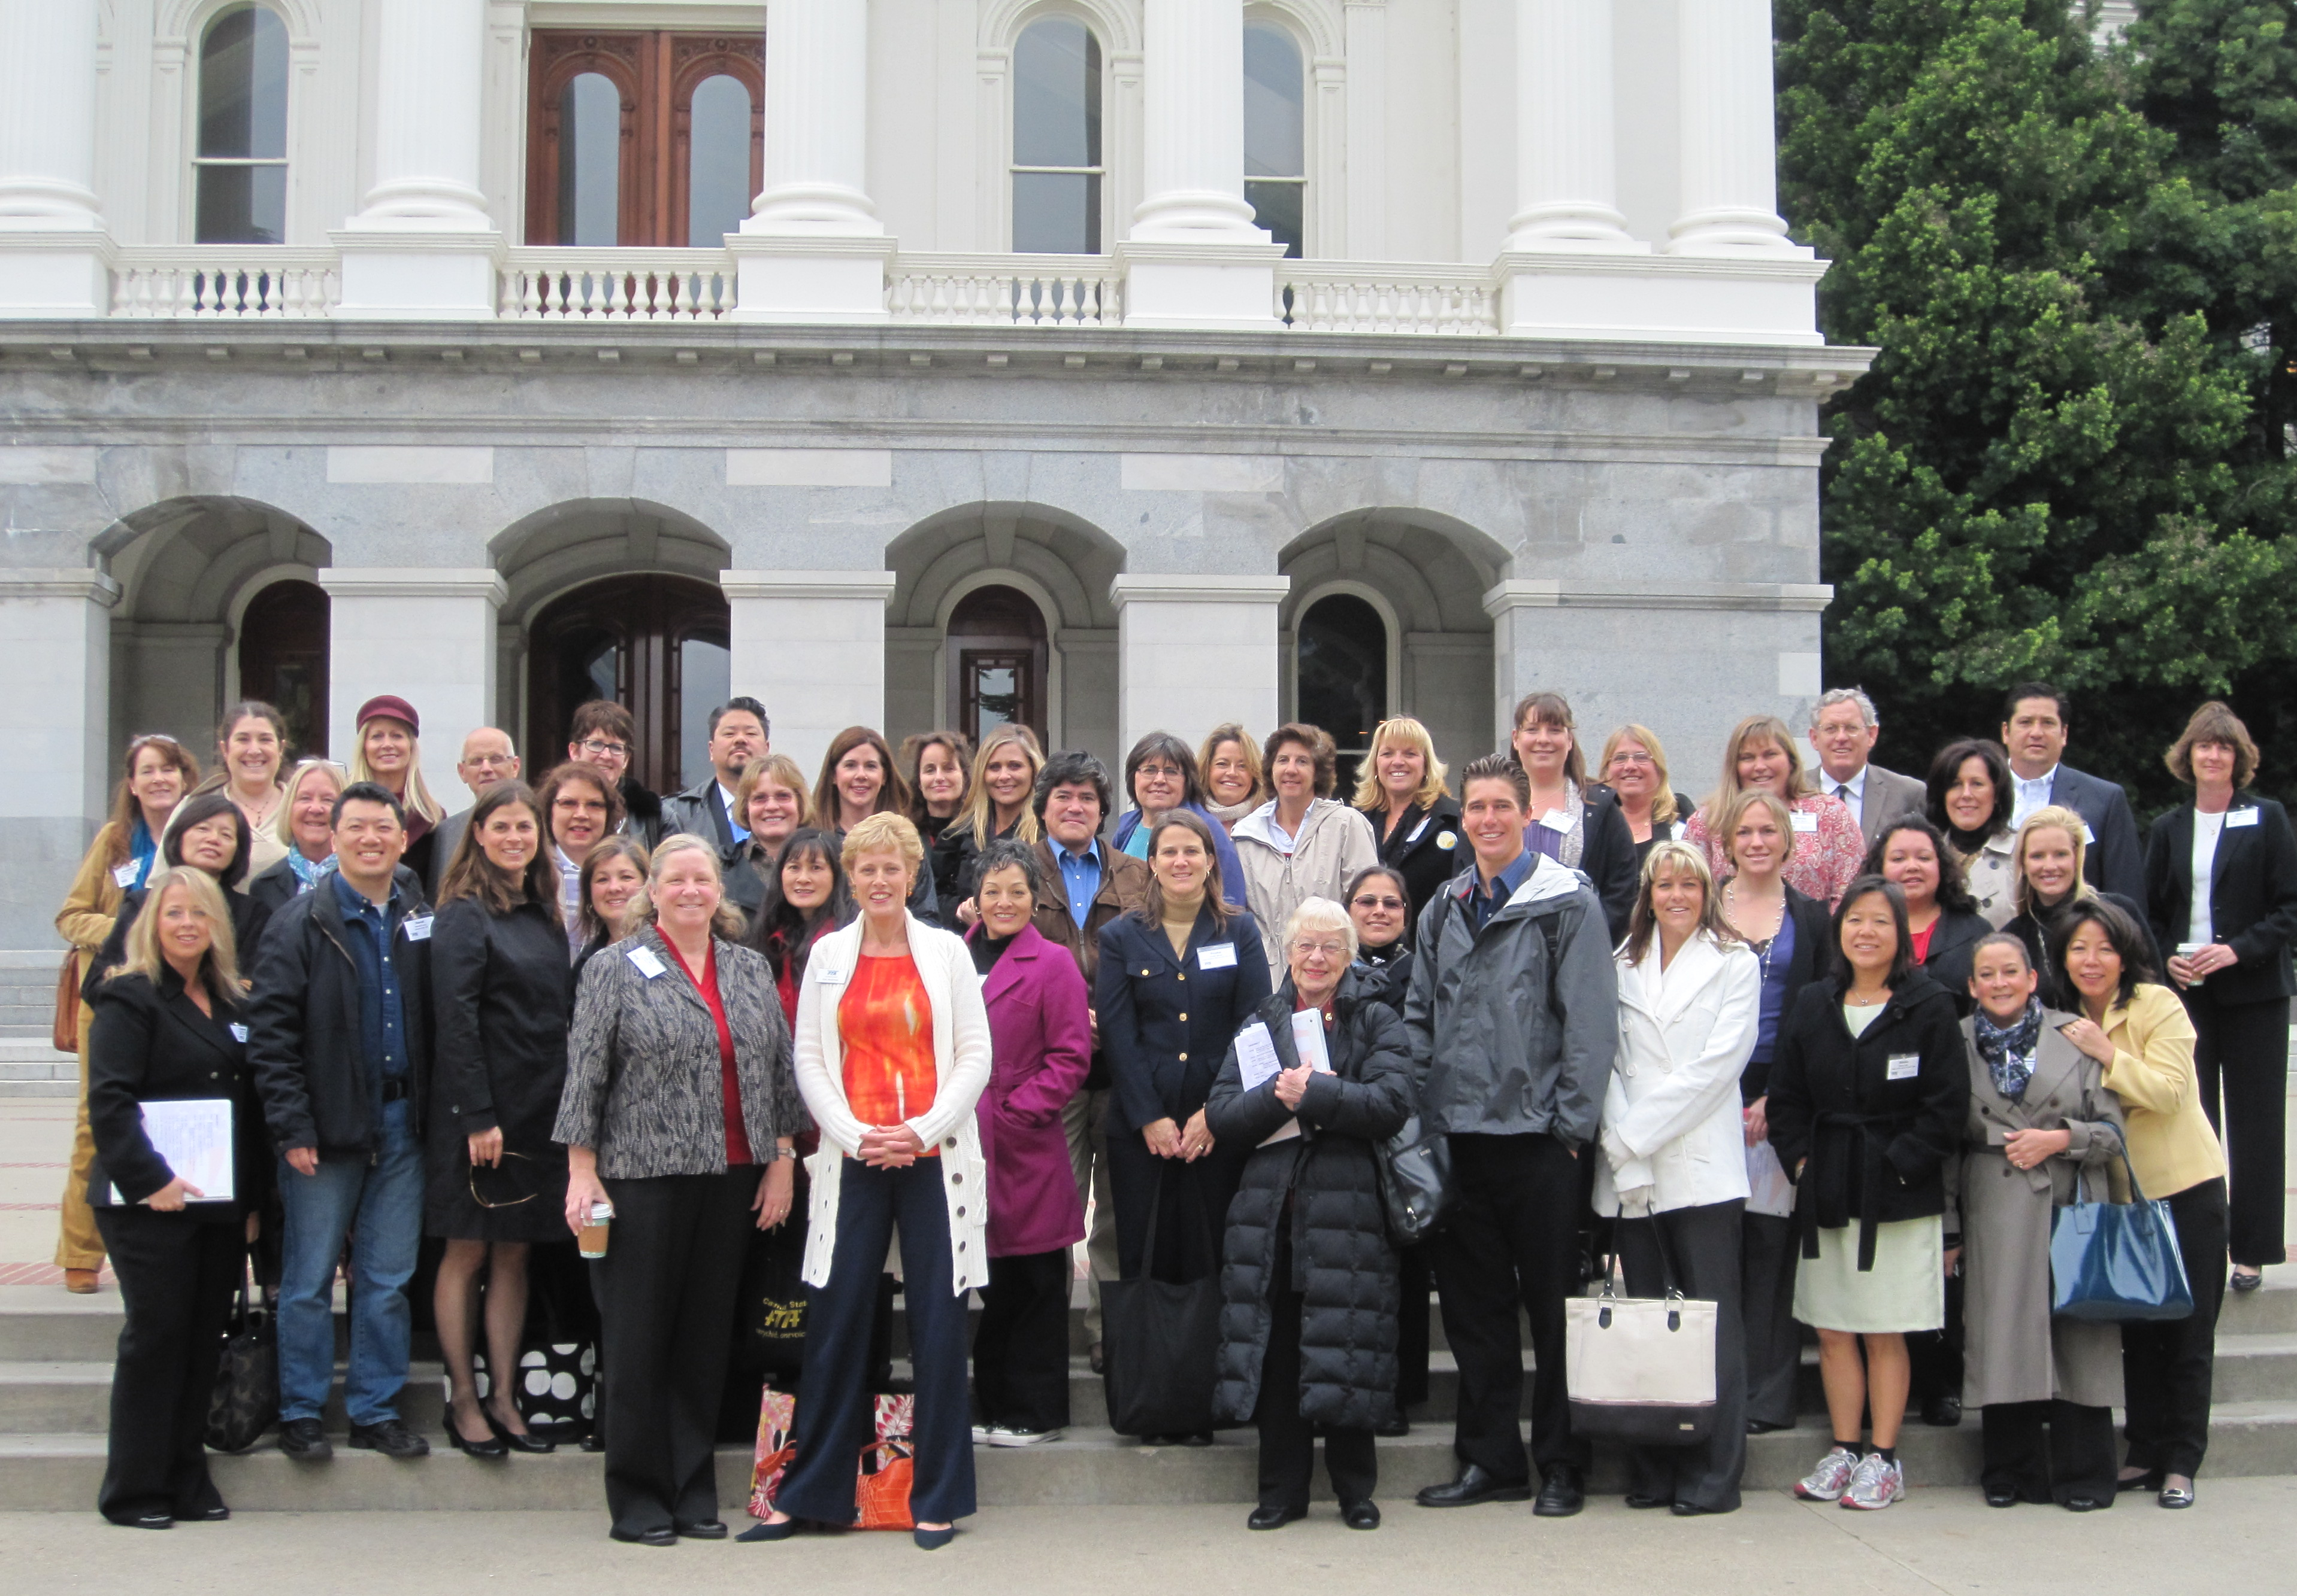
PTA: Creates Candidates
PTA members are not prohibited from running
for public office.
We are well informed and committed.
Keep PTA separate
from campaign.
Do not use PTA
resources.

Slide 23
PTA: Takes positions on ballot measures
Publically endorse or oppose
Propose a ballot measure
Organize signature-gathering

Slide 24
PTA: Takes Positions
Our Children, Our Future:
Studied the issue – PTA authority
Drafted language
Approved by Board of Managers
Organized volunteers
Hosted campaign events
Did not spend PTA financial resources

Slide 25
PTA: Takes Positions
Our Children, Our Future update:
Signature validation status
Campaign management
Expectations of PTA
members
Next steps

Slide 26
PTA: Ballot Measures
IRS considers ballot measure work to be a lobbying activity.
Voting public act as legislators when they vote on the proposed legislation in the measure.
PTA allowed “insubstantial” lobbying activity.

Slide 27
PTA: Upcoming Elections
★ June 5 Primary Election Ballot
Proposition 28
Proposition 29
★ November 6 General Election Ballot
Numbers to be assigned
Statewide Ballot Measures
6 currently qualified for Ballot
6 Pending Signature Verification
Tax Initiatives

Slide 28
PTA: Role in Elections
Important Dates:
★ Tuesday, June 5 – Primary Election Date
★ Tuesday, November 6 – General Election
VOTE! Polls are open from 7:00 a.m. – 8:00 p.m.
Oct 8 - 30: Vote-by-mail voting
Oct 22: Last day to register to vote
Oct 23 – Oct 30: New resident
registration period

Slide 29
PTA: Role in Elections
★ NONPARTISAN ★
Before
During
After

Slide 30
PTA: Resources
CA PTA Toolkit @ www.capta.org
1.3 Basic Policies
1.3.3 Nonpartisan Policy
4.3 Election Campaign and the Role of the PTA
National PTA @ www.pta.org
Our Children, Our Future Campaign
www.ourchildrenourfuture2012.com

Slide 31
PTA: Resources
Orange County Registrar of Voters
www.ocvote.com
California Secretary of State
www.sos.ca.gov./elections/

Slide 32
Presented by:
Shereen Walter
Advocacy Training & Speakers Bureau
speakers@fourthdistrictpta.org
Fran Sdao
Advocacy Roundtables Chairman
roundtables@fourthdistrictpta.org

Slide 33
Thank you for attending this evening!
For more information
and advocacy resources, go to:
www.fourthdistrictpta.org
⬇ ⬇ ⬇ ⬇ ⬇
Kim Anderson, VP Advocacy
advocacy@fourthdistrictpta.org

