Slide 1
Equity in Arts Education
Resources for Arts Advocacy
Notes:
Welcome and Introduction
Thank attendees
Today we are going to go over some arts research, resources to help you advocate, and we will share with you an exciting state-wide movement that you can be a part of!

Slide 2
► We believe that every child has the right to a dynamic, creative education.
► If we are not teaching arts, we are not teaching the whole child.
► Creativity is not optional!
Notes:
Ask the audience:
Raise your hand if you had arts education when you were in school
Raise your hand if your child/ grandchild has arts classes in their school now
Raise your hand if those art programs are fully or partially funded by PTA

Slide 3
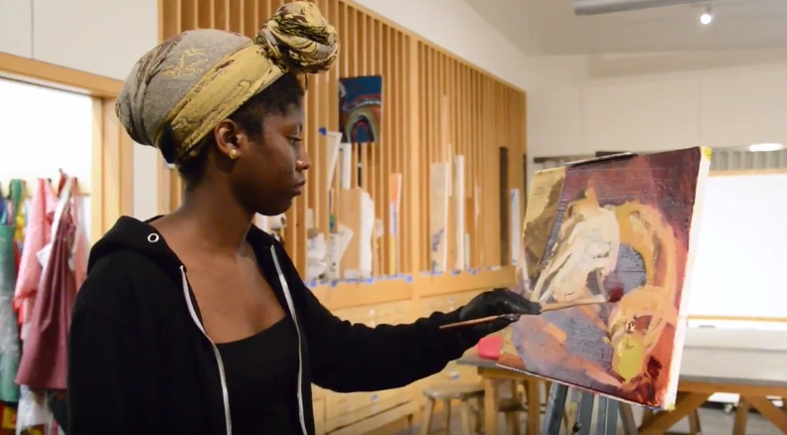
The research is clear…..
ARTS improve education!
Notes:
There is a strong correlation between art and achievement:
Students who participate in the arts are 4 times more likely to be recognized for academic achievement
Students who study art are 3 times more likely to have good attendance
Art is proven to help at risk students

Slide 4
93% of Americans believe that the arts are vital to providing a well-rounded education.
Notes:
• Students who take four years of arts and music classes average almost 100 points higher on their SAT scores than students who take only one-half year or less.
• 72 percent of business leaders say that creativity is the number one skill they are seeking when hiring.

Slide 5
Education Code
California Education Code 51210
California Education Code 51220
Notes:
As if all the data wasn’t impressive enough for schools to include the arts into daily curriculum, it is in the Ed Code. This means that it is mandated that the arts be a part of a full, comprehensive curriculum.
California Education Code Section 51210 (grades 1-6) & 51220 (grades 7 -12) states that the adopted course study for grades 1-12 include the following areas of study: visual and performing arts, including dance, music, theatre and visual arts aimed at the development of aesthetic appreciation and the skills of creative expression.

Slide 6
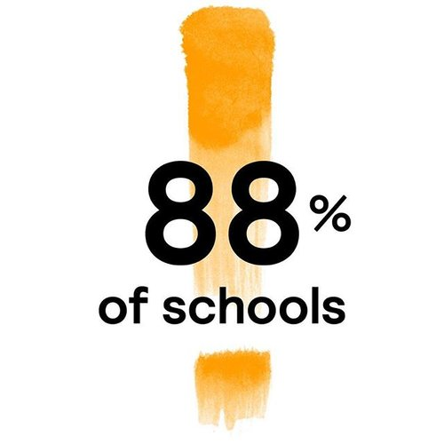
What does this mean for your child?
Your child has the right to a quality education.
But right now, 88% of California schools aren’t fully teaching it.
By leaving out the arts for some or all students, these schools are in violation of California law.
Notes:
Read this slide – it is impactful!!!

Slide 7
The “Whole Child” Approach
Makes learning more interactive
Fosters interdisciplinary learning
Builds self-esteem
Facilitates student success despite differences in languages or learning styles
Source: Buchbinder, J. (1999). Arts step out of the wings. Retrieved from www.edletter.org/past/issues/1999-nd/ arts.shtml
Notes:
The pendulum of education has swung back this way – teachers and administrators are seeing more and more the value of teaching to the whole child.

Slide 8
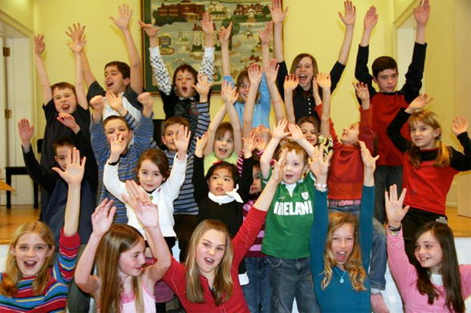
Resources
The VAPA Guide
Arts Education Data Project
Notes:
California State PTA and our arts partners have some amazing resources for you:
Our VAPA Guide (hold it up for all to see)
The Arts Education Data Project – a website with tons of great information

Slide 9
What is the VAPA Guide?
www.capta.org
Notes:
What does VAPA stand for? Wait for responses, then answer – Visual and Performing Arts.
This guide was written for parents by CAPTA and CreateCA. Currently, t is available online in English and Spanish languages.

Slide 10
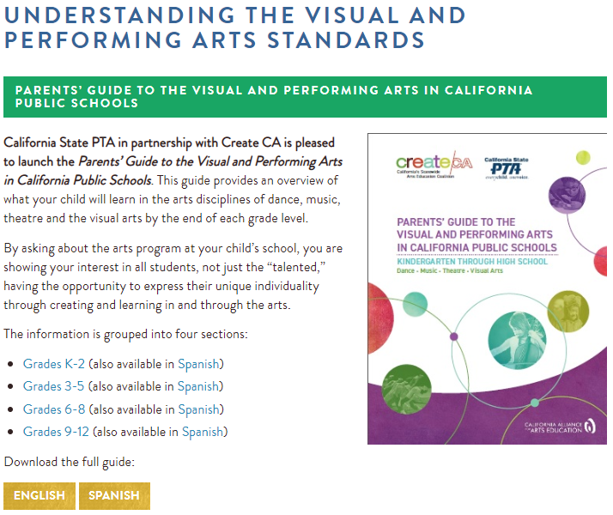
The VAPA Guide has been translated into Spanish and is available on the CAPTA website.
Notes:
California recently updated the state’s arts education standards. These standards, newly entitled “The California Arts Standards for Public Schools, Prekindergarten Through Grade Twelve,” now include media arts.
Next, the California Department of Education (CDE) is developing the California Arts Framework for Public Schools, Kindergarten Through Grade Twelve (Arts Framework) to incorporate and support the new California Arts Standards.
Once that is completed, we will update our VAPA Guide and translate the updated version into multiple languages – Arabic, Chinese, Spanish, and Tagalog.

Slide 11
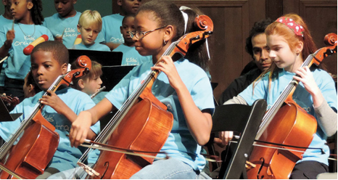
The five domains of arts education
Dance
Music
Theatre
Visual Arts
Media Arts
Notes:
So to recap, as of January 2019, we now have 5 domains of arts education.
In the newly adopted state standards media arts has been added to dance, music, theater, and visual arts.

Slide 12
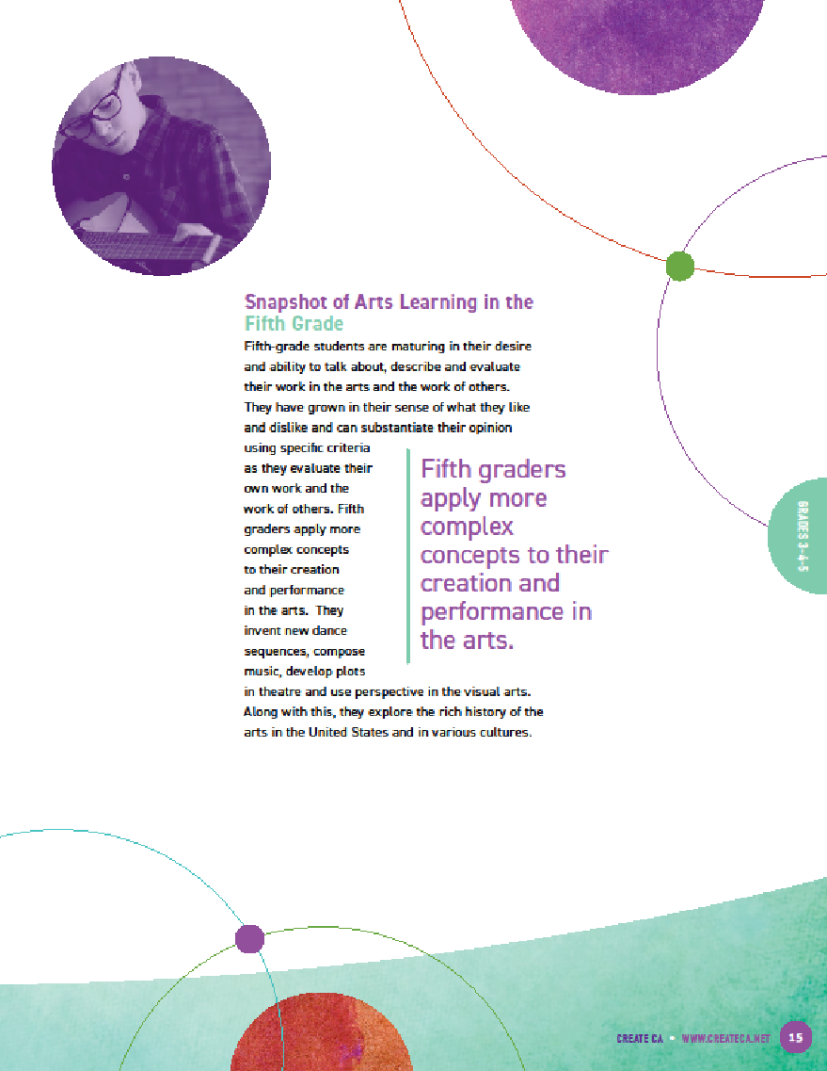
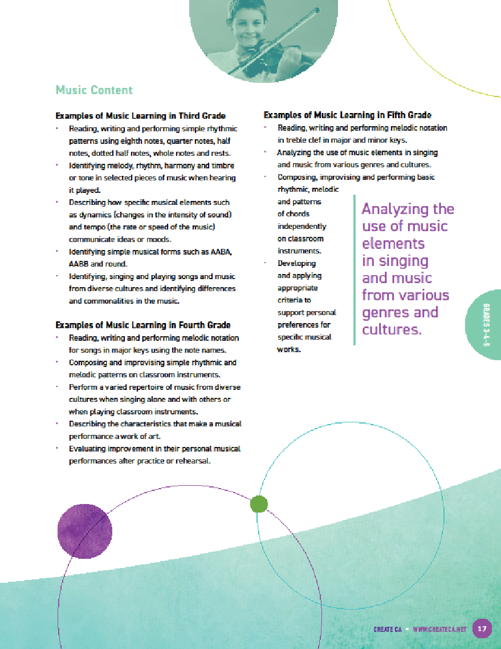
The VAPA Guide is broken up by grade
Notes:
The VAPA Guide is broken up by grade levels: Kindergarten through 2nd grades, 3rd through 5th grades, 6th through 8th grades, and 9th through 12th grades.
The guide shows the sequential skills your child should be learning.
At the end of each grade section, there are sample questions to ask concerning your child’s progress in arts learning and about the school’s arts program.
Talking to your school’s principal and school board about the importance of sequential arts education is effective!
There are also tips for ways to increase arts learning at home and in your community.

Slide 13
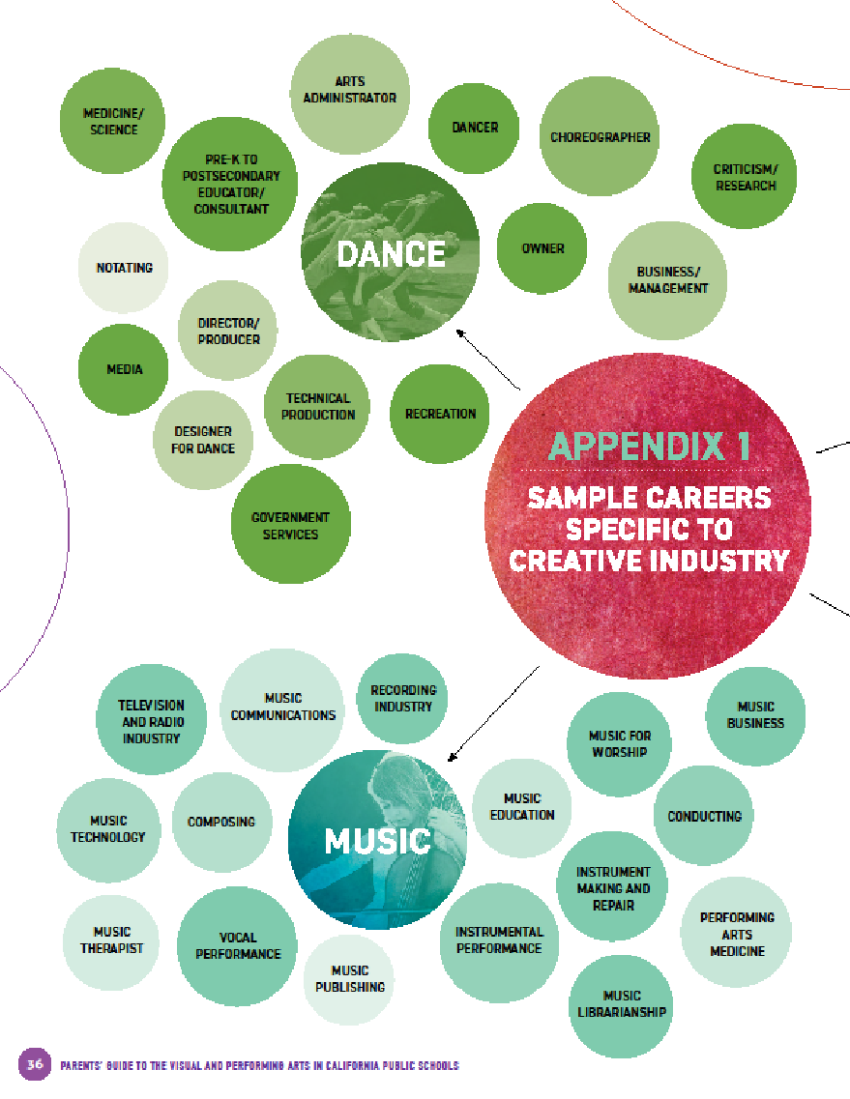
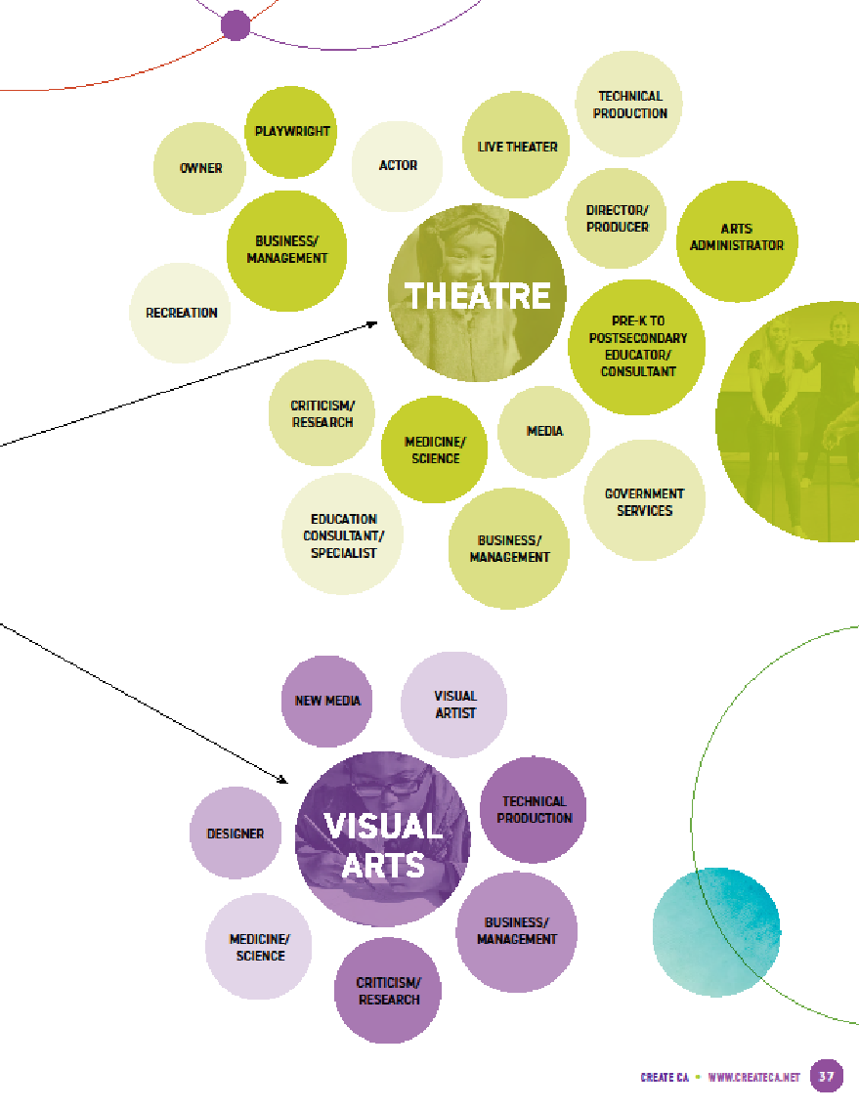
Notes:
An arts education is vital to California’s robust, globally competitive, creative economy.
Every child deserves the same opportunities to be a vital part of a creative workforce.
The arts are important for lifelong learning, the development of 21st century skills and college and career readiness.
NOW is the time for the resurgence and expansion of arts instruction in California’s public schools!
Because CREATIVITY IS NOT OPTIONAL!!!

Slide 14
Arts Education Data Project http://www.createca.dreamhosters.com/artsed-dataproject/
Notes:
The VAPA Guide lets you know what should be happening in every school district – and the Arts Education Data Project shows you if it's actually happening.
Until now, we lacked the tools to show us where (and how) arts education is offered across the state. That’s why CreateCA, the California Department of Education, and the National Arts Education Data Project have joined together to provide a new suite of tools to help increase participation and ensure student success through the arts.
The Arts Education Data Project helps you see what arts offerings there are in your school, school district, and statewide for grades 6-12.
Note: Kindergarten through 5th grade data is not included on the website at this time.

Slide 15
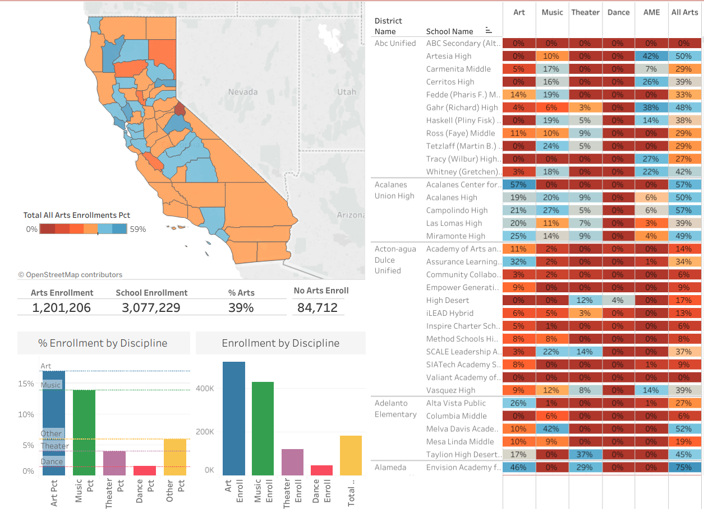
Notes:
Only 39% of children in the state take an arts class-- that leaves 2.1 million 6th through 12th graders without art.
There are 85,000 kids in the state who have NO art classes offered at their school – this is a huge equity issue!
Across the state only 17% of students enrolled in art classes:
14% in music
6% in media arts
4% in theater
2% in dance
we can do so much better than that!

Slide 16
Notes:
CAPTA has partnered with Create CA, and arts & education agencies from across the state to launch a new public will campaign.
We are working to unite people, communities, and organizations under the shared vision that every student can – and must – receive a dynamic, sequential education through the arts.
To reach every child, it will take all of us! Please visit capta.org to get more information on arts advocacy, to share your arts story, and to find links to the campaign website.
Working together we can make a difference for children across California, and let our voices be heard. CREATIVITY IS NOT OPTIONAL!
Thank you!

