Slide 1
Michael Essien, Principal
MLK Middle School
350 Girard Street, San Francisco, CA 94134
Phone: (415) 828-7112
EssienM@sfusd.edu
Follow on Twitter:
@MichaelCEssien
@MLK_MS

Slide 2
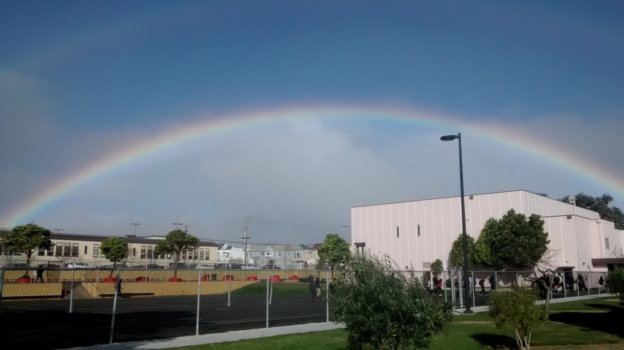
Whole School Approach to Social Emotional Learning
February 25, 2019
Notes:
Coaching; data, sel

Slide 3
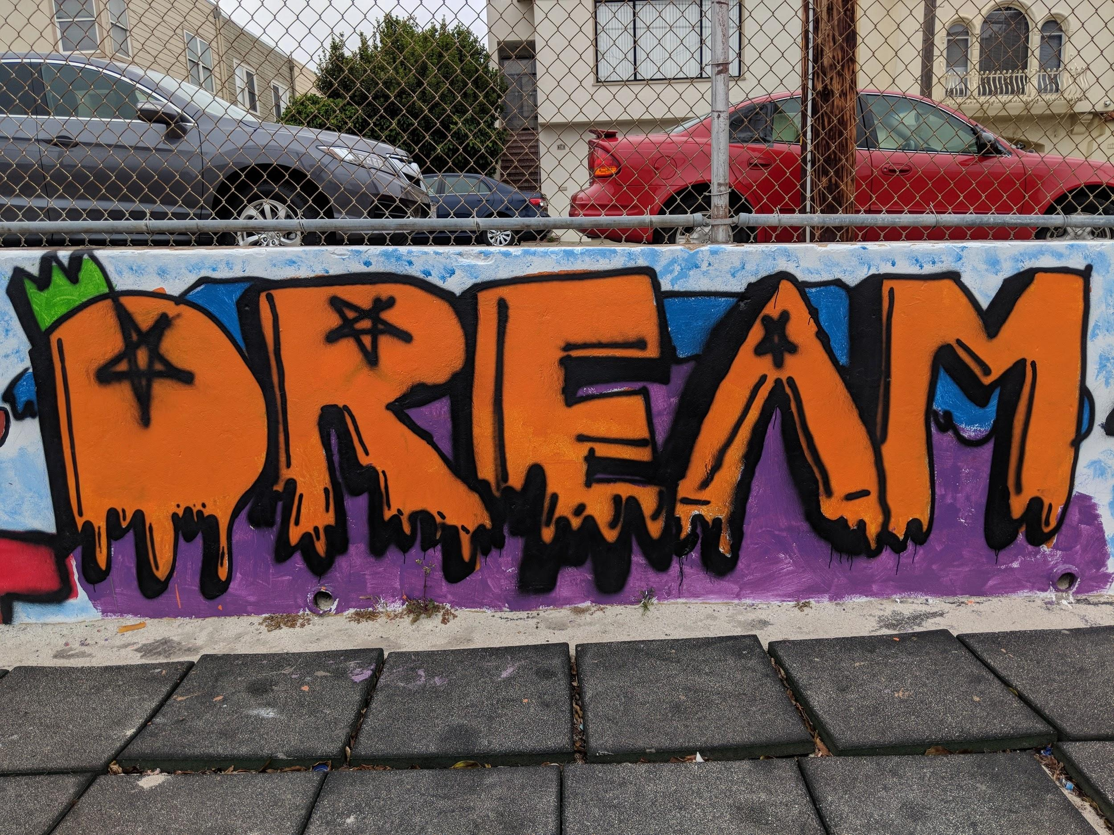
MLK’s Context
Middle School in Southeast SF
514 Students
23 Content teachers
26% English Learners
12% Sped
Population: 37.4% Asian, 29.8% Latino, 12.7% AA, 6.7% Filipino, 6% Two or More, 2.3% White, 2.3% Unknown, 2.1% Native Hawaiian, 0.6% Native American
78.3% Socio-economically disadvantaged
6 Period Day (4 + 1)
Community School

Slide 4
Healthough 360
BVHF
Bayview YMCA
Huckleberry Youth
Legacy
3rd Street Youth Clinic
Young Community Developer
Mentoring for Success
Presidio YMCA Bikes Program
SF Food Bank
UOP Dental
Bay Area Scores
SNS
Partners In School Innovation
New Tech Network
YCBA
JRAP
SF Jazz
SF Film Society
Walt Disney Museum
Presidio Trust
SFPC
MindCatcher
Identity Devel (?)
Bayview Beacon
JCYC ETS
USF College Access
UTB
Ultimate Impact
Y-Bike
Spark
Teaching & Learning
Expanded Learning
Behavioral Health
Spark
Bayview Beacon
YCD
JCYC ETA
USF College Access
Avid
SF Ed Fund
Google
Woodland Cum
Collective Impact
Bayview Beacon
YCD
PPS
Portola Family Connections
Hang To (Vietnamese School)
Tzu Chi (Chinese School)
C.S.
Family Partnerships
College, Career & Transitions
Notes:
Most current list of agencies: Most current
Hard slide to see

Slide 5
Mindsets
Principal Community School Coordinator
Equity & Social Justice Equity & Social Justice
Whole Student Healthier Families =
Youth are better able to learn
Teacher/Student relationship is Magic happens in the classroom
most important
Strategic Thinking & Distributed Listening, Learning & Supporting ALL
Leadership
Relational Trust Connector across ALL Stakeholders
Community Mapping

Slide 6
Mindsets continued...
Pre - Community Schools Current (2015-16 to now)
Teachers were Social Workers
Over 40 Community Partners on site = $2.3 million
Different parts of the school working TOGETHER
Different parts of the school working in SILOS
Only 9 (out of 23) teachers retained at MLK
22 (out of 23) teachers retained at MLK
Over 380 students are receiving additional academic, health and mental health support
Only 30 students received additional support

Slide 7
14-11-9
Notes:
An appropriate learning environment for students and teachers needed to be established
Traditionally, SEL is a stand alone curriculum taught in a specific classroom. It assists students with learning how to cope with emotions in a variety of situations.
MLK decided to define SEL as any interaction between people on the campus: student to student, student to teacher, teacher to teacher. These interactions can occur in the classroom related to instruction, classroom management, passing in the hallways, in the cafeteria, detention, and/or in the administrator’s office,

Slide 8
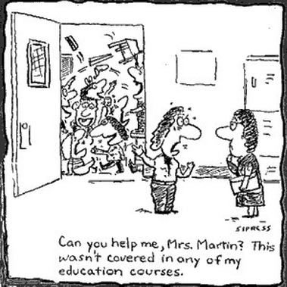
Notes:
Cartoon speaks to the symbiotic relationship within instruction. Needed to build the capacity of teachers to address the challenges faced in the classroom.

Slide 9
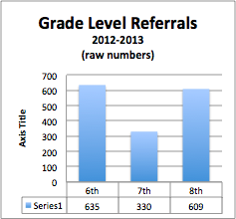
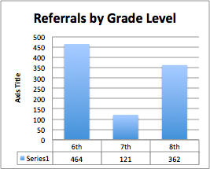
Back to Back Yearly Grade Level Comparisons

Slide 11
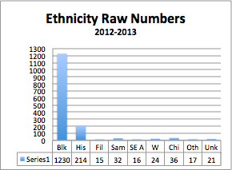
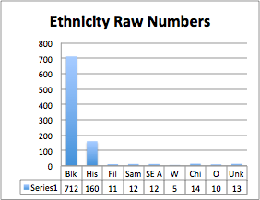
Back to Back Yearly Ethnic Comparisons

Slide 13
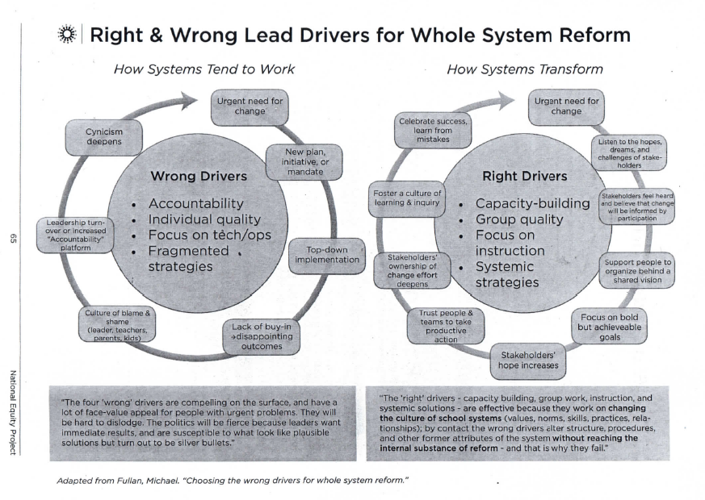
Notes:
Compare & Contrast; noticings, implications, questions

Slide 14
Student & Teacher Relationships
Change is Required
Notes:
Nothing is more important than the relationship between students and teachers. It is where instruction occurs. Need to funnel all resources and supports to nurture and strengthen this relationship.

Slide 15
Notes:
Students and Parents needed us to address the needs of their children walking into our classrooms, both academic and social emotional.
Dual nature of education; building the plane while flying it.
Maslow: physiological, safety needs, loving and belonging, esteem, self-actualization
Bloom: remember, understand, apply, analyze, evaluate, create

Slide 16
Maslow
Bloom
Restorative Practices
Pax Good Behavior Game
De-escalation Training
M
M
M
Student Voice & Choice
Arts Integration
Project Based Learning
B
B

Slide 17
Whole School Approach
Culture Club & Pupil Services
Instructional Leadership Team
Notes:
It was about teacher development. The

Slide 18
Culture Club
(Teacher PD)
De-escalation Training
Pax Good Behavior Game
Transitions
Beat the Timer
See, Hear, Do, Feel
Tootles
Equity Sticks
Restorative Practices
Circles
Mediations
Peer Mediations

Slide 19
De-Escalation Training

Slide 20
Whenever possible, intervening before a person is escalated!
Know the triggers!

Slide 21
5 Kernels
Harmonica (transitions)
Beat the Timer/Clock
See, Hear, Do, Feel Chart
Tootles
Equity Sticks
Notes:
Trauma informed; student self-regulation

Slide 22
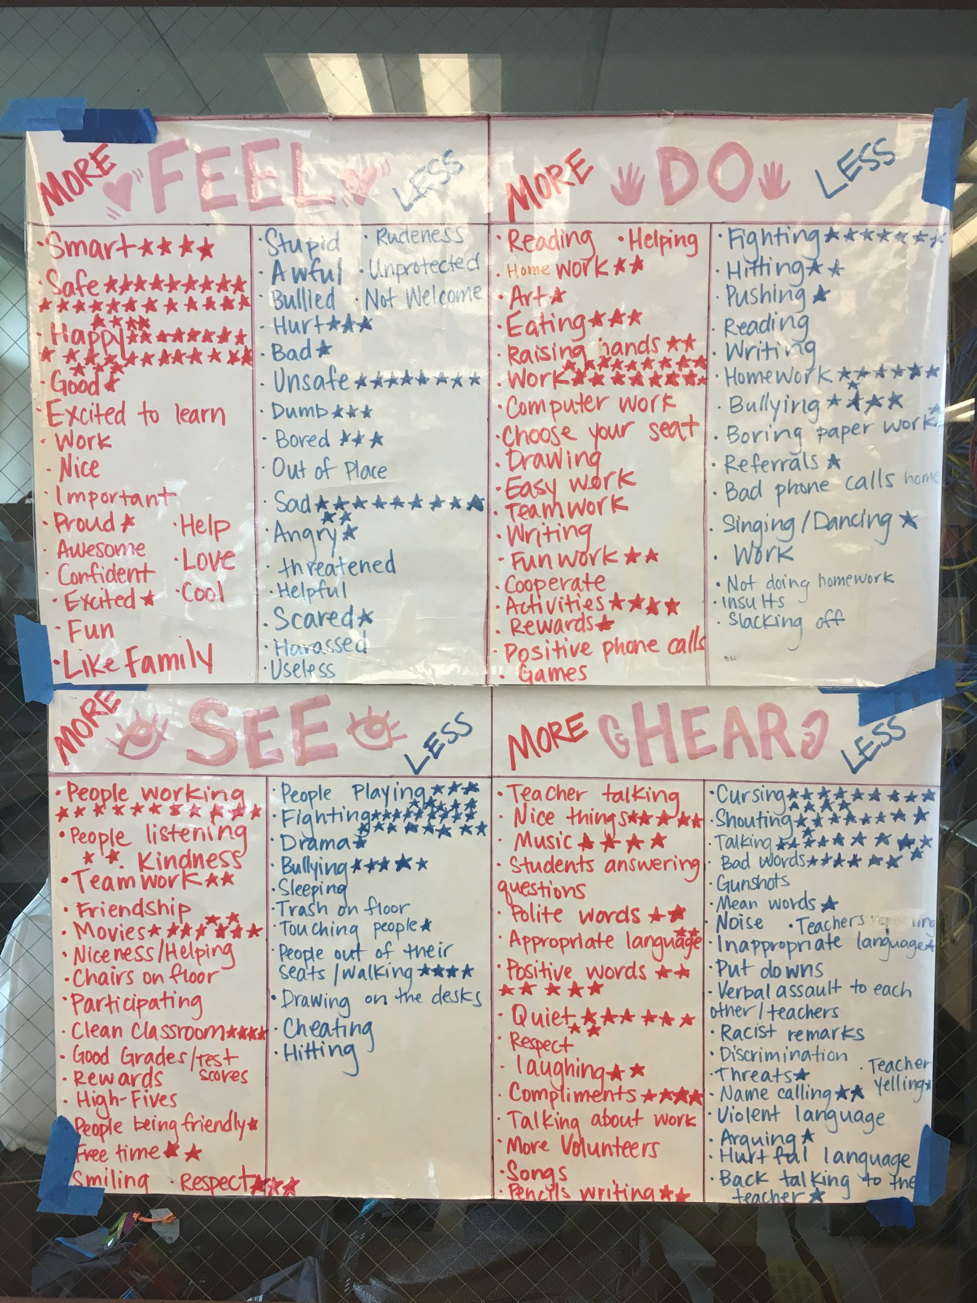
See, Hear, Do, Feel Chart

Slide 23
Comparisons
2013-2014
Consequences for not following instructions
Warning
Five minute time out (with teacher discretion)
Parent/Guardian phone call
Buddy Room
Office referral or classroom suspension
(Note: Teacher may start student at a higher-level based on recent behavior)
2017-2018
Student Rights
Reminder (previously “Warning”)
Take-5
Push-In*
Call Home
Office Referral
*Push-In can be used to assist students at any time

Slide 24
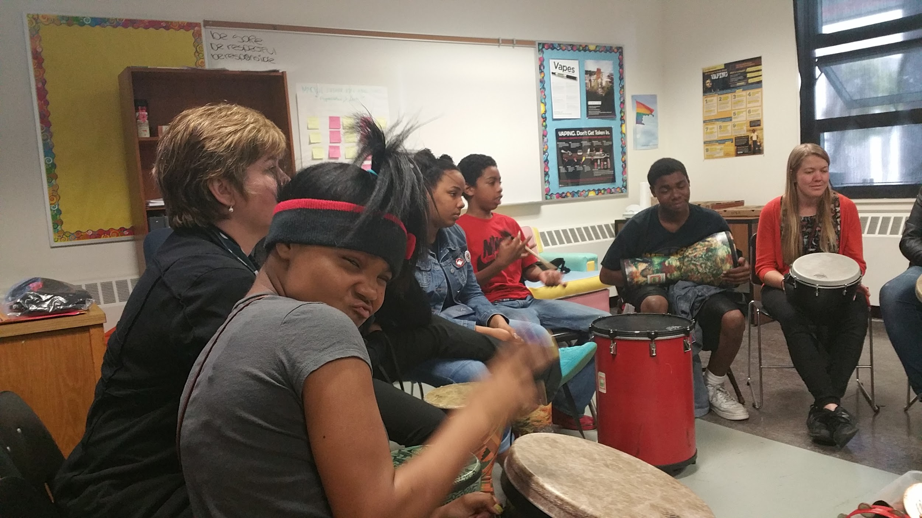
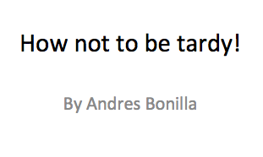
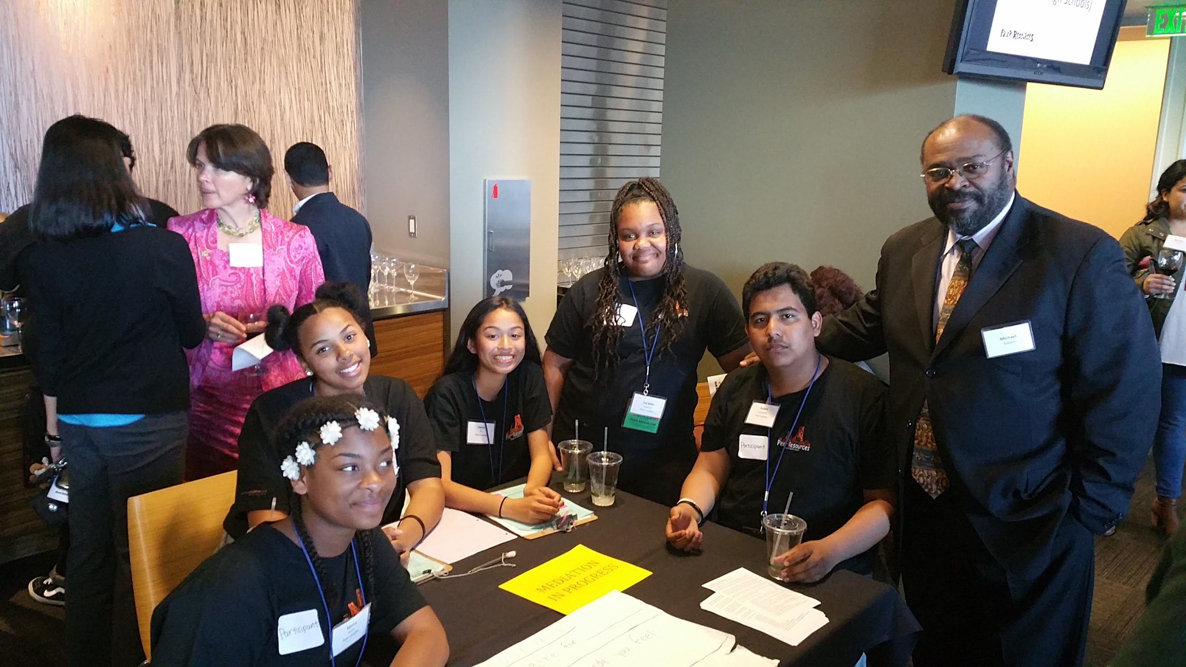
Restorative Practices
Weekly Circles
Peer Mediations
Mediations
Re-entry process for conflict
Student Power Points & Presentation
Write Poem healing the situation
Drawing healing the situation
Boys Group
Girls Group
Lunch Time Circle
Student PPT
Peer Mediation Team

Slide 25
Instructional Leadership Team
(Teacher PD)
Student choice & voice
Peer Resources
Cogenerative Groups
Project Based Learning
Culture that Empowers
Teaching that Enables
Arts Integration

Slide 26
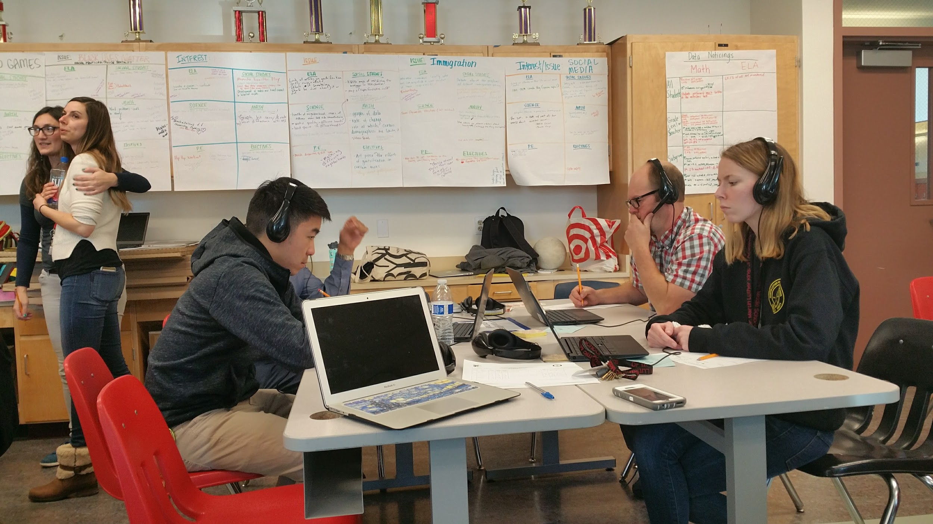
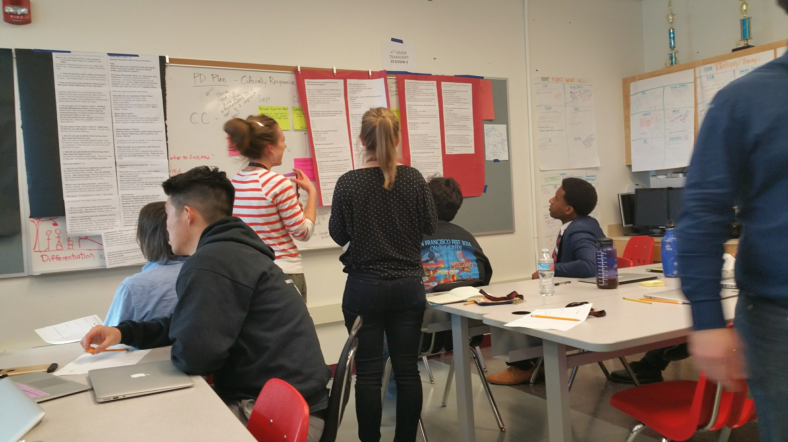
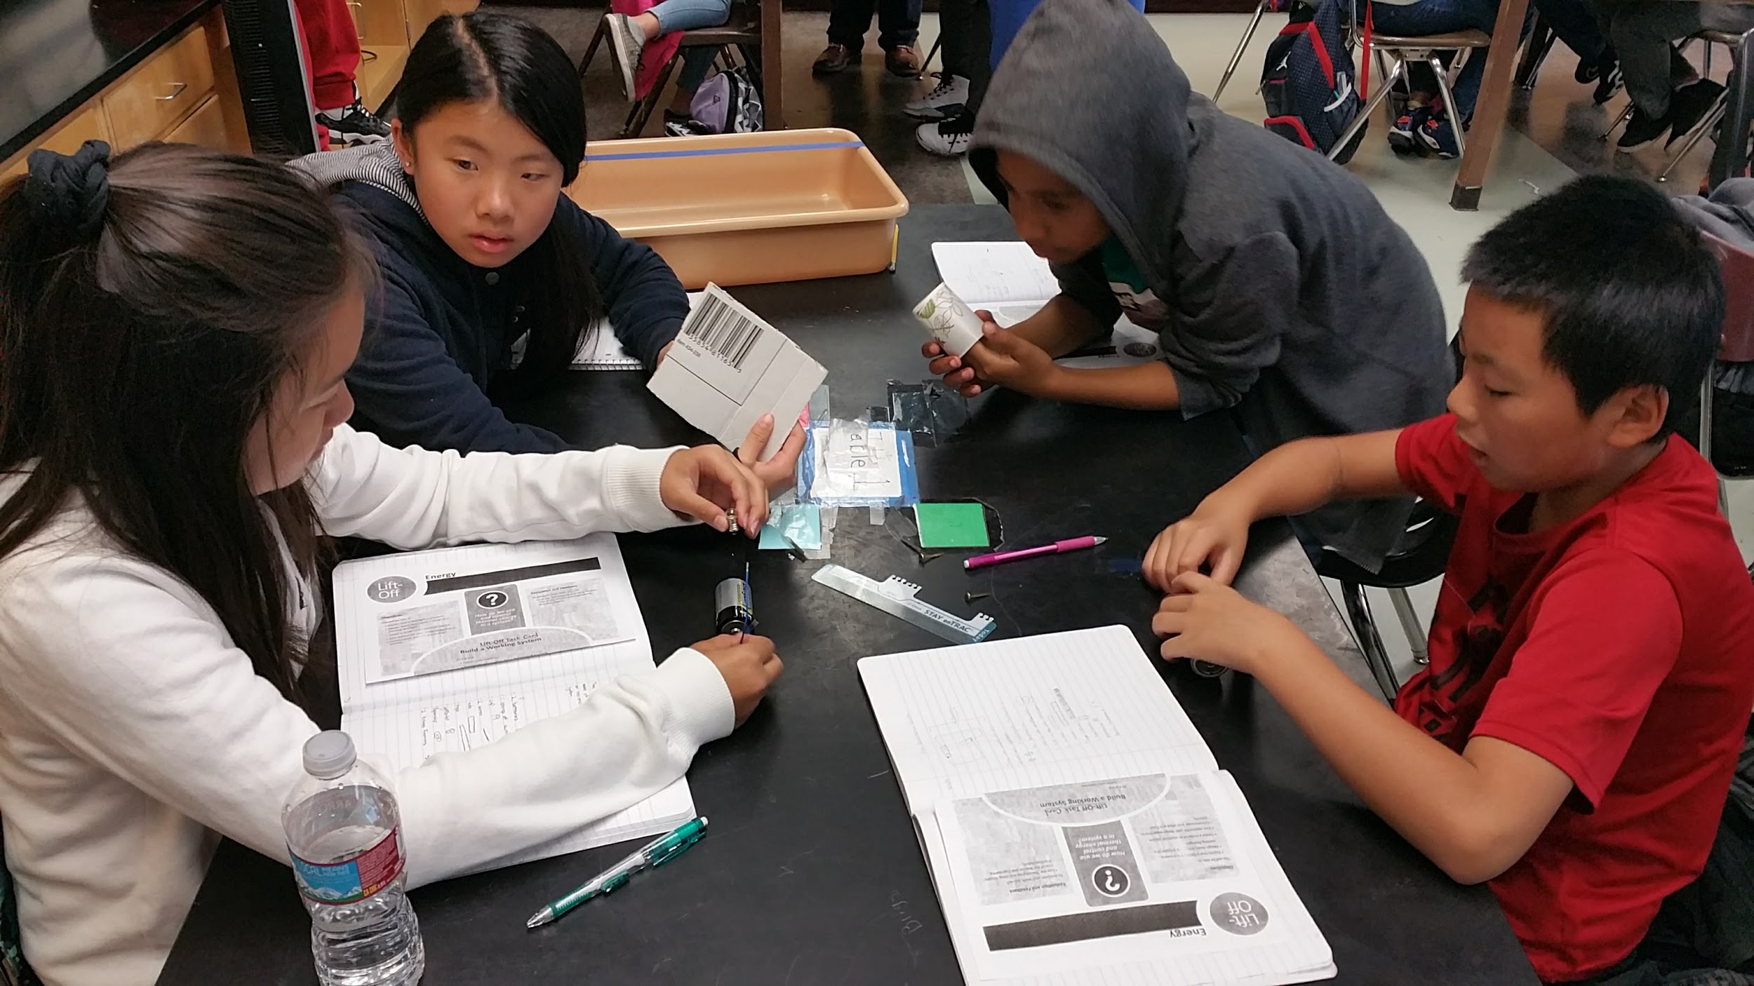
Student Voice & Choice
Voice
Choice

Slide 27
Project Based Learning
Experiential Learning
Student as expert of their background knowledge
Motivation/Engagement of students
Critical Thinking
Solving Problems relevant to students
Expanding classroom boundaries

Slide 28
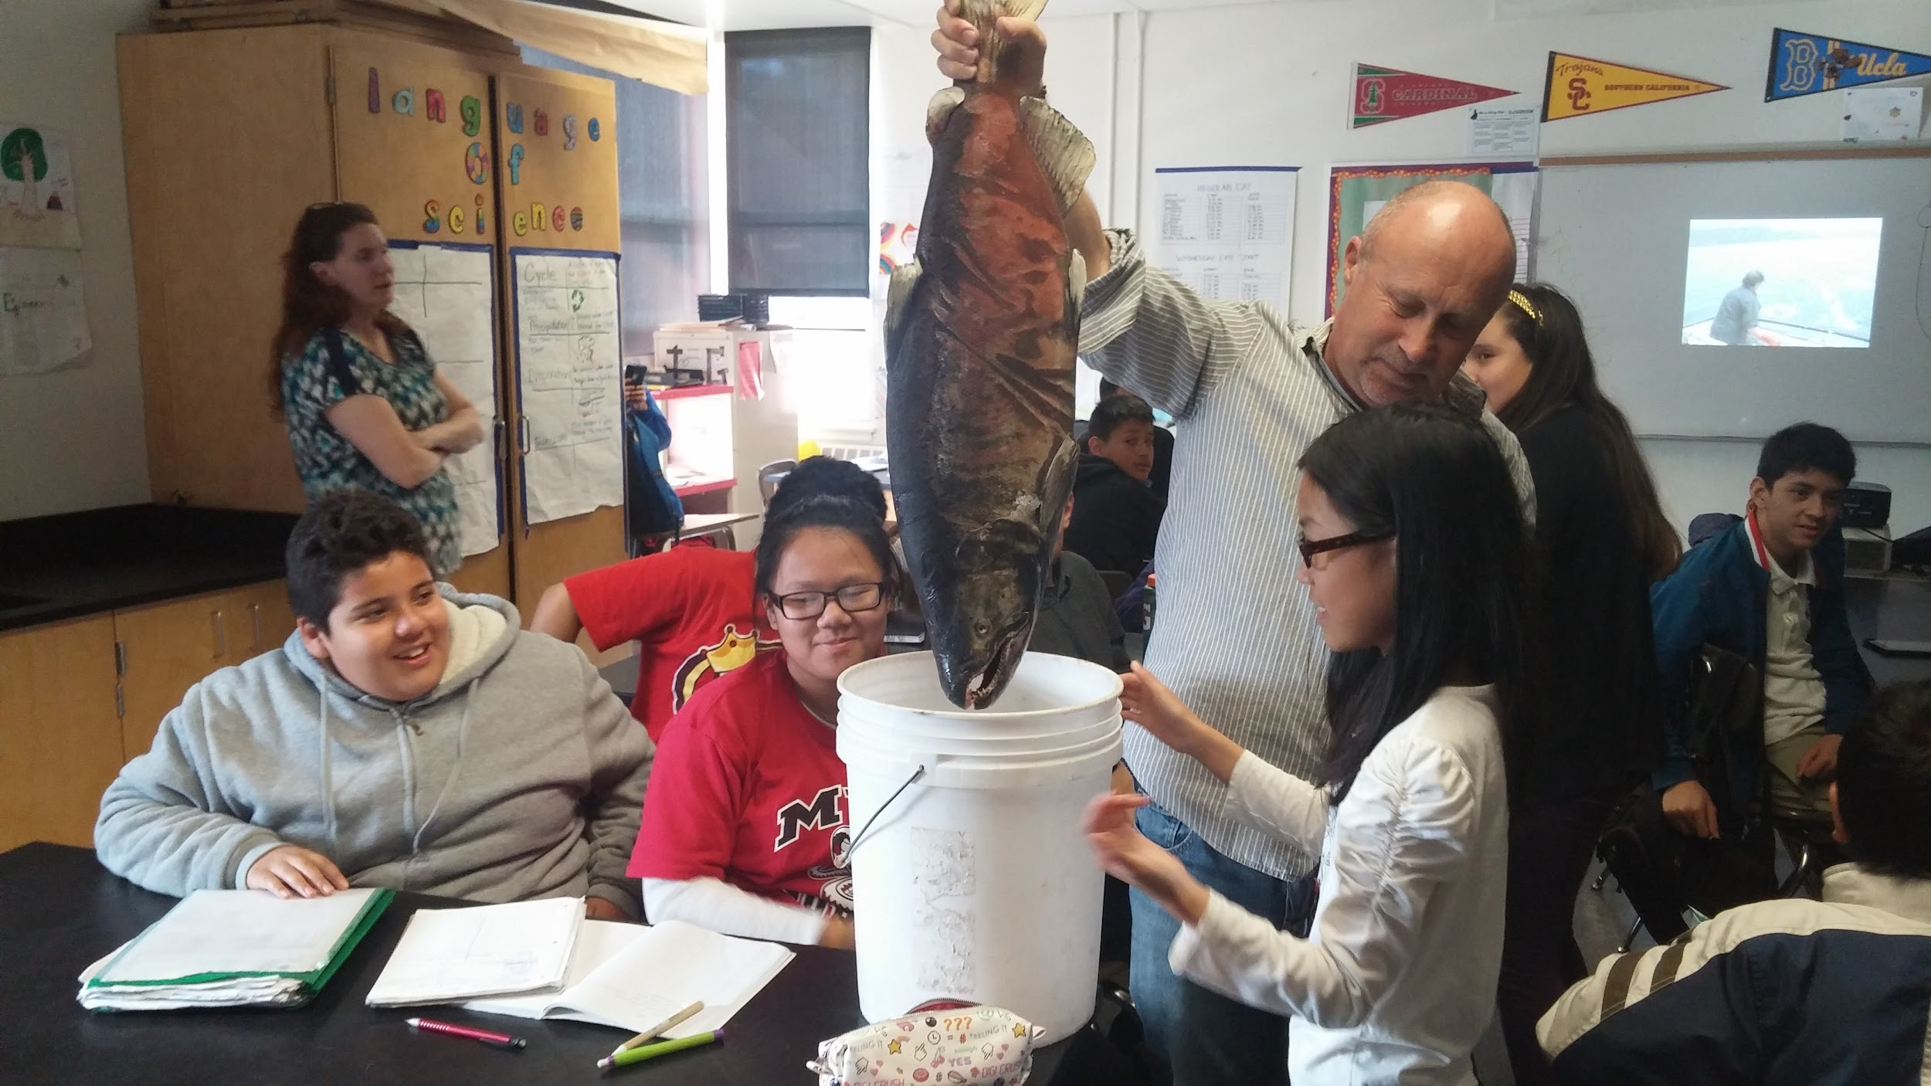
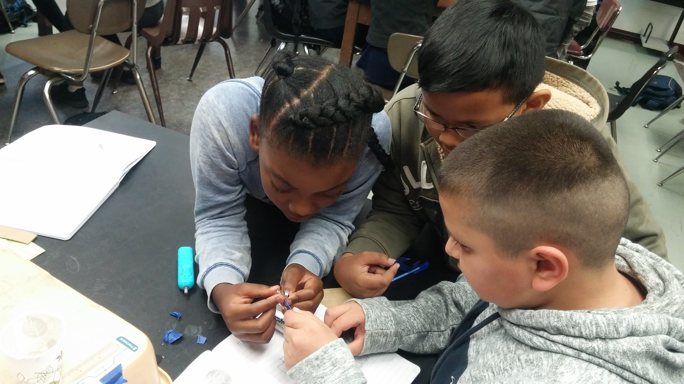
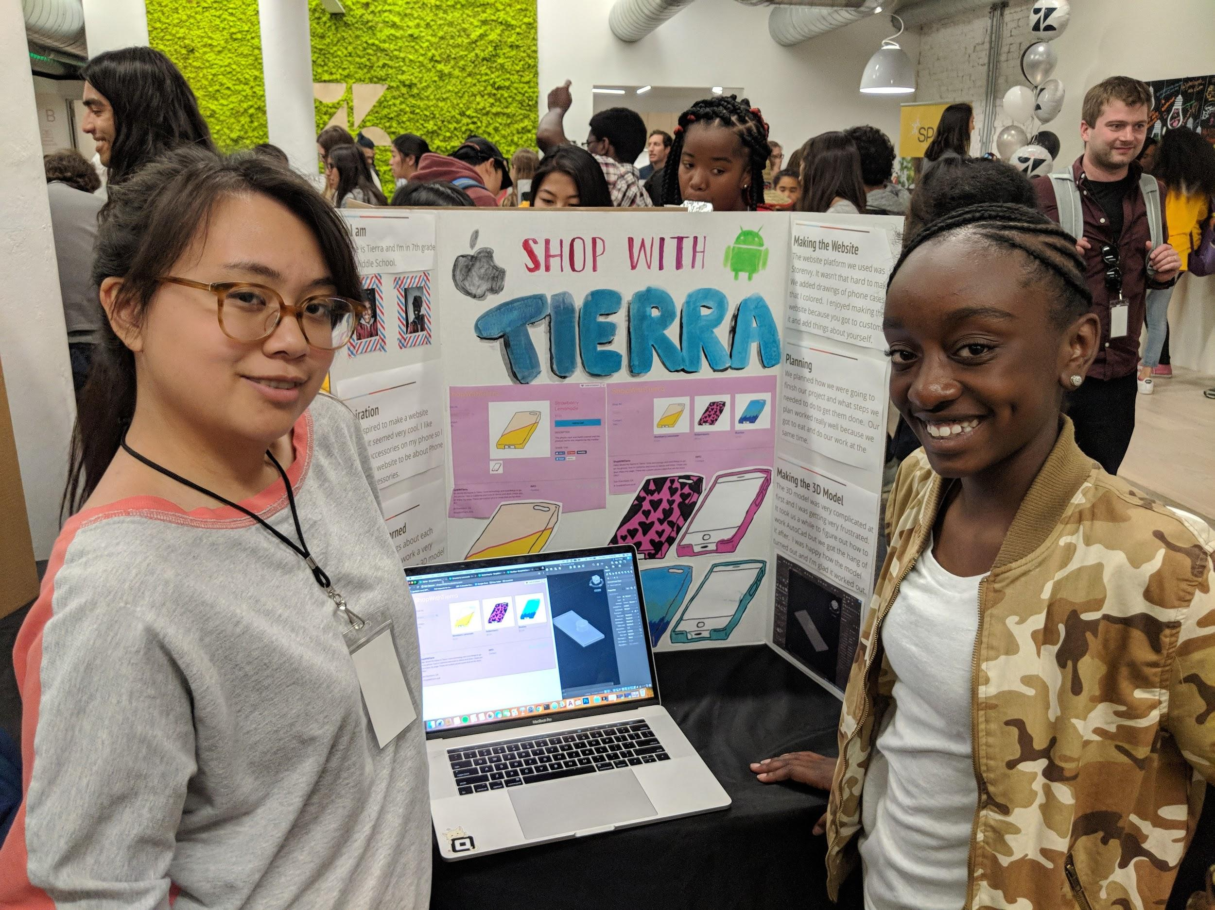
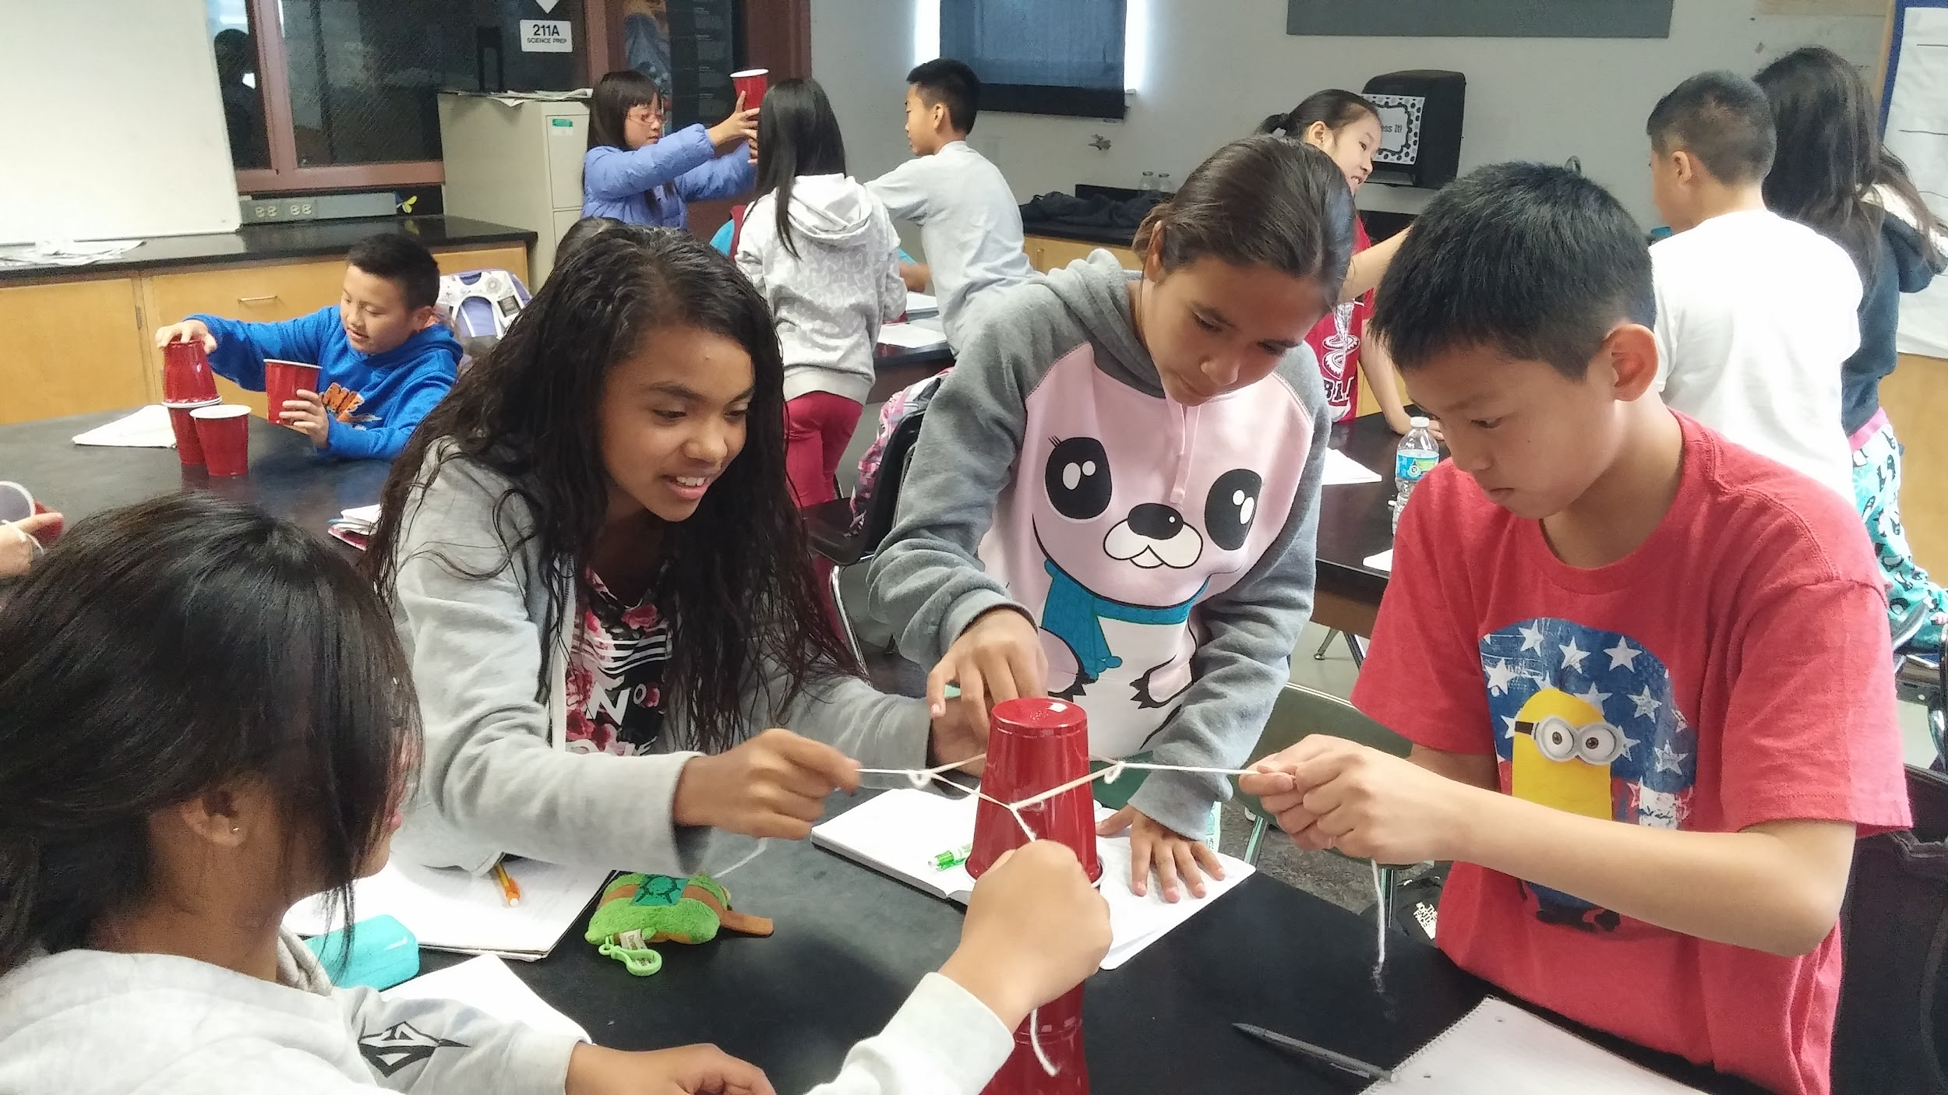
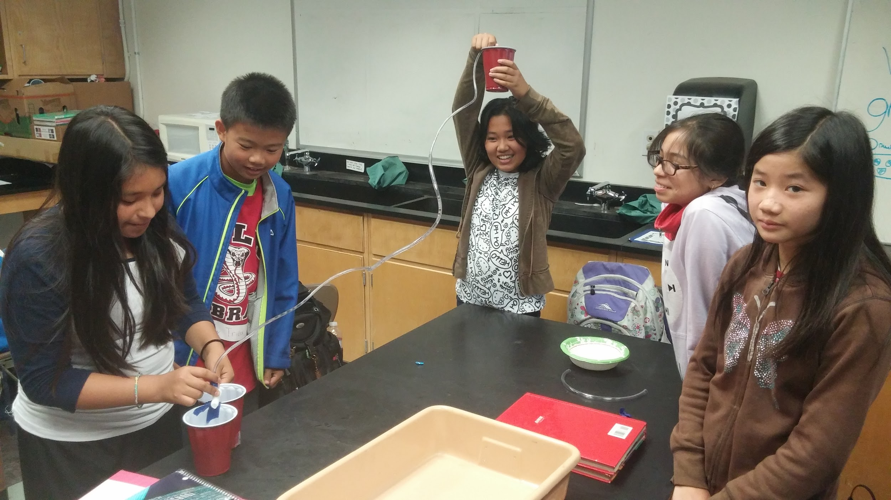
PBL Continued...

Slide 29
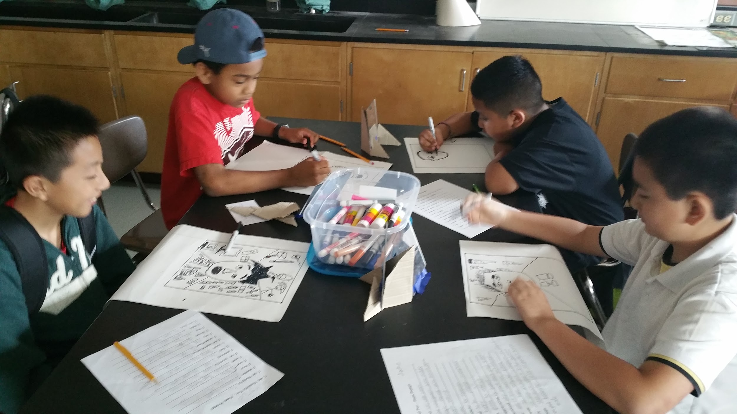
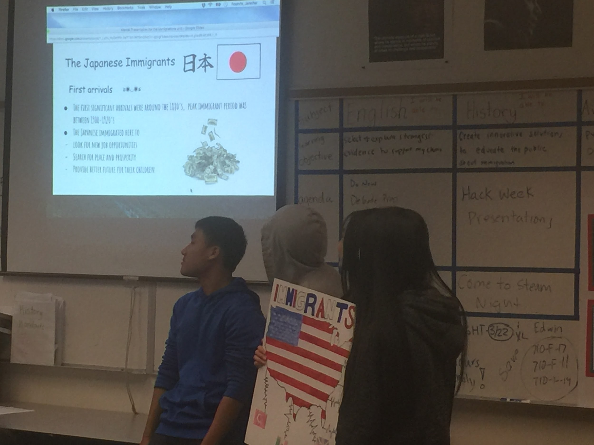
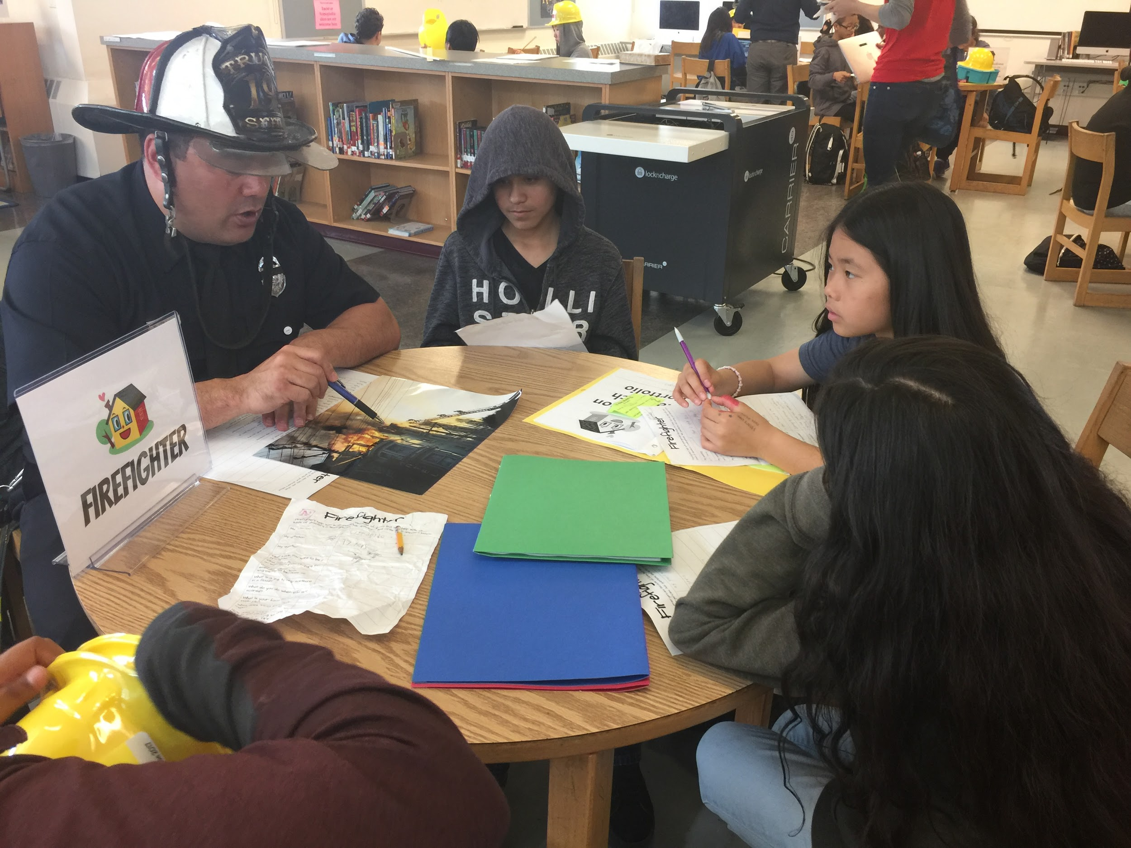
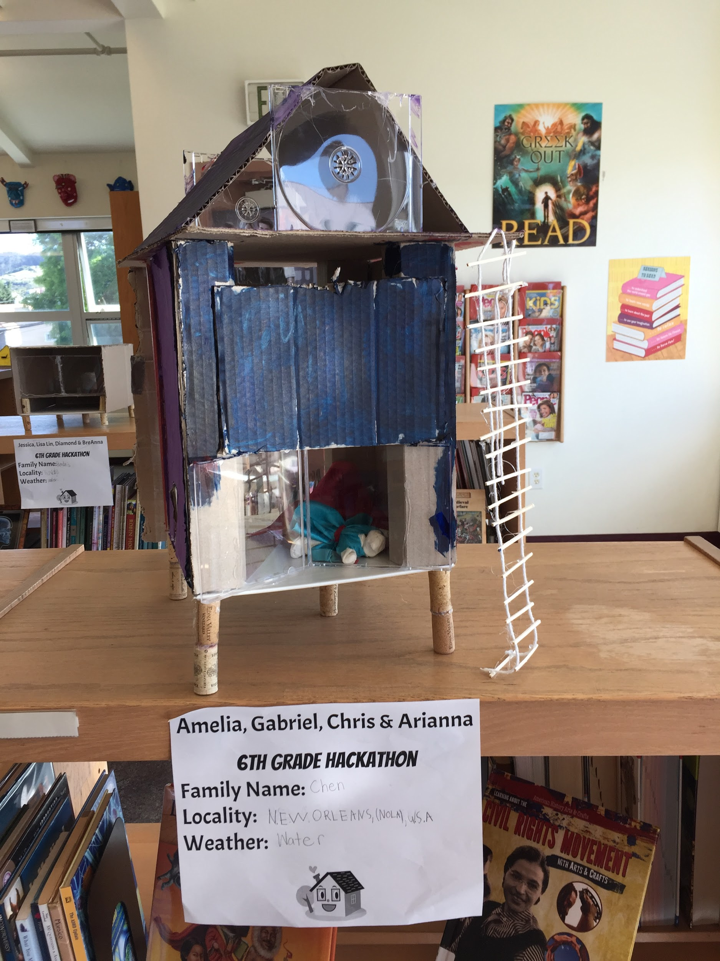
Arts Integration & Partnerships
Social Studies
Science
ELA
Notes:
Art is incorporated into all core content
Yerba Buena Center for the Arts
Jerry Rosenstein Arts Project
MindCatcher
Attitudinal Healing

Slide 30
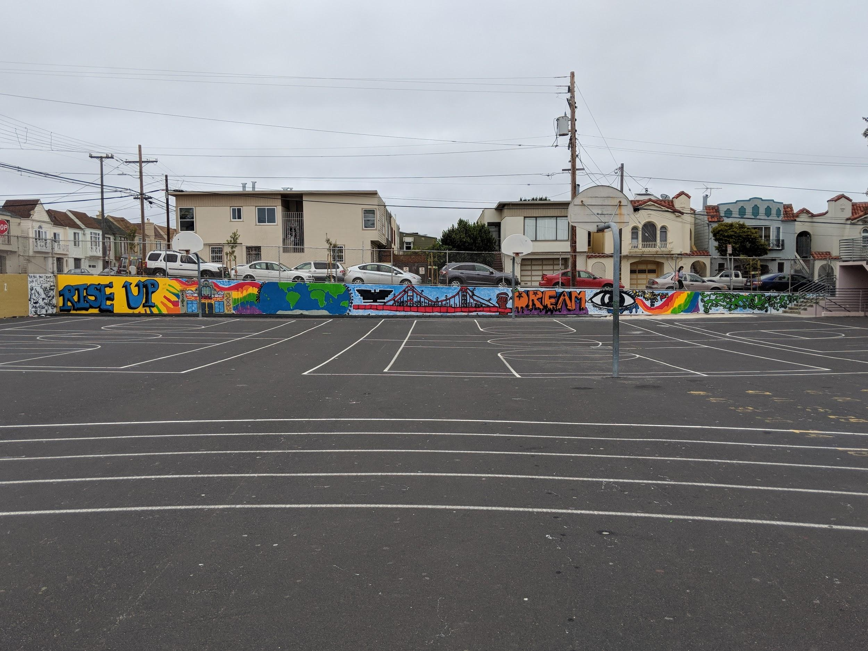

Slide 31
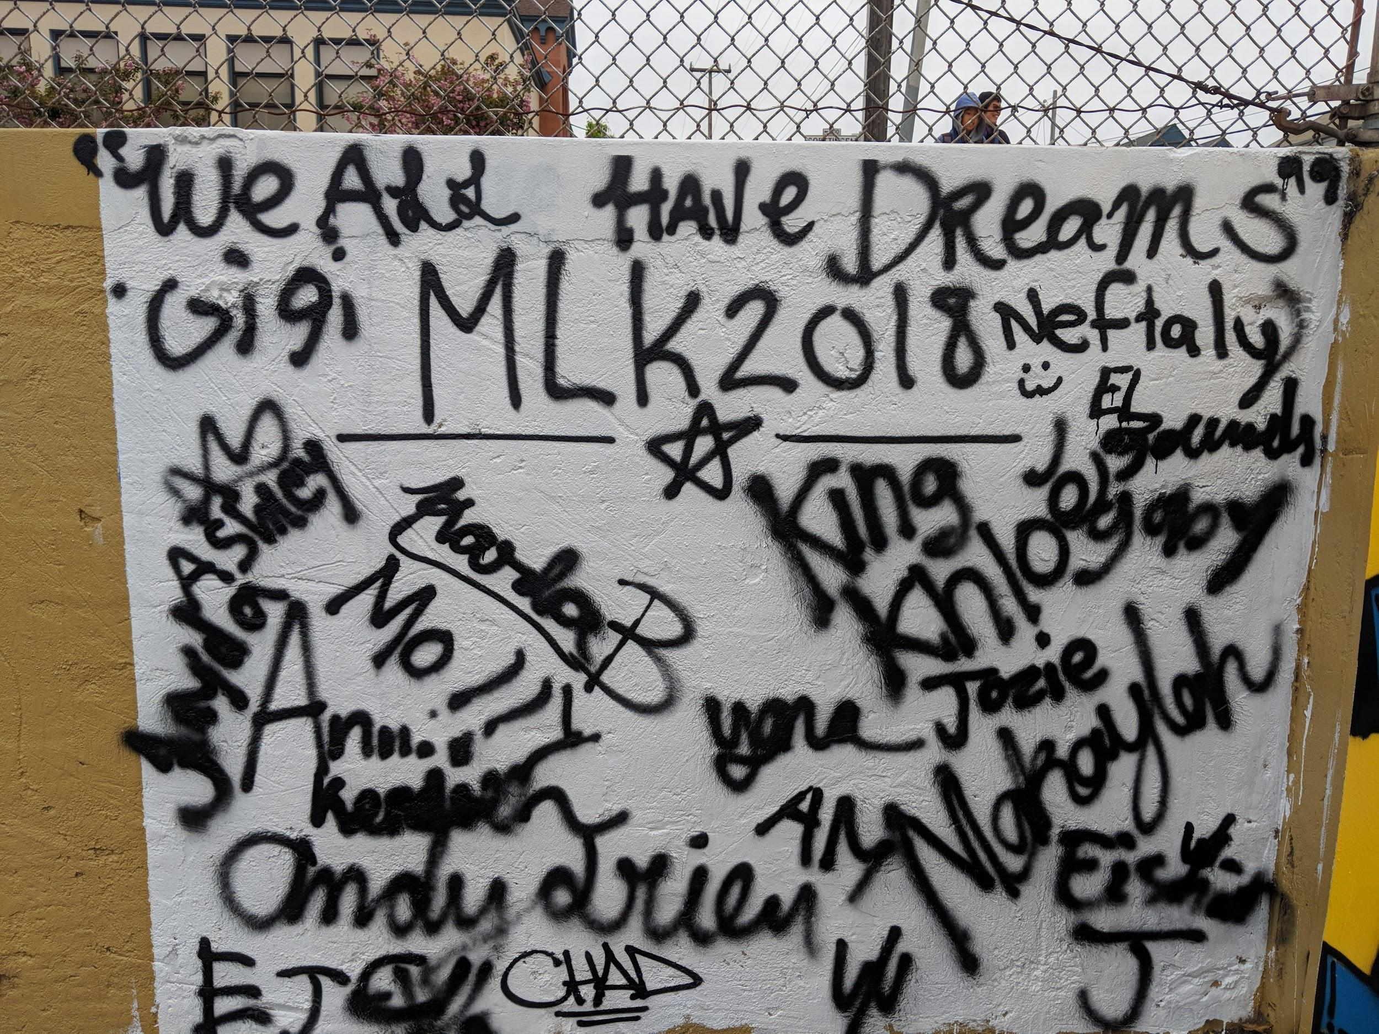
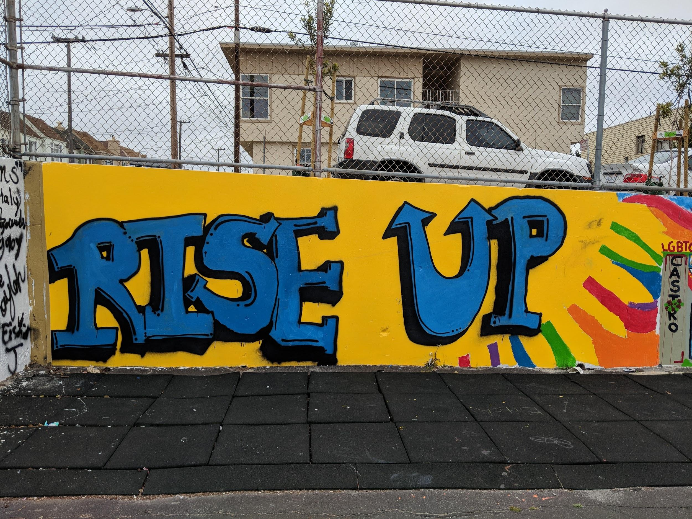
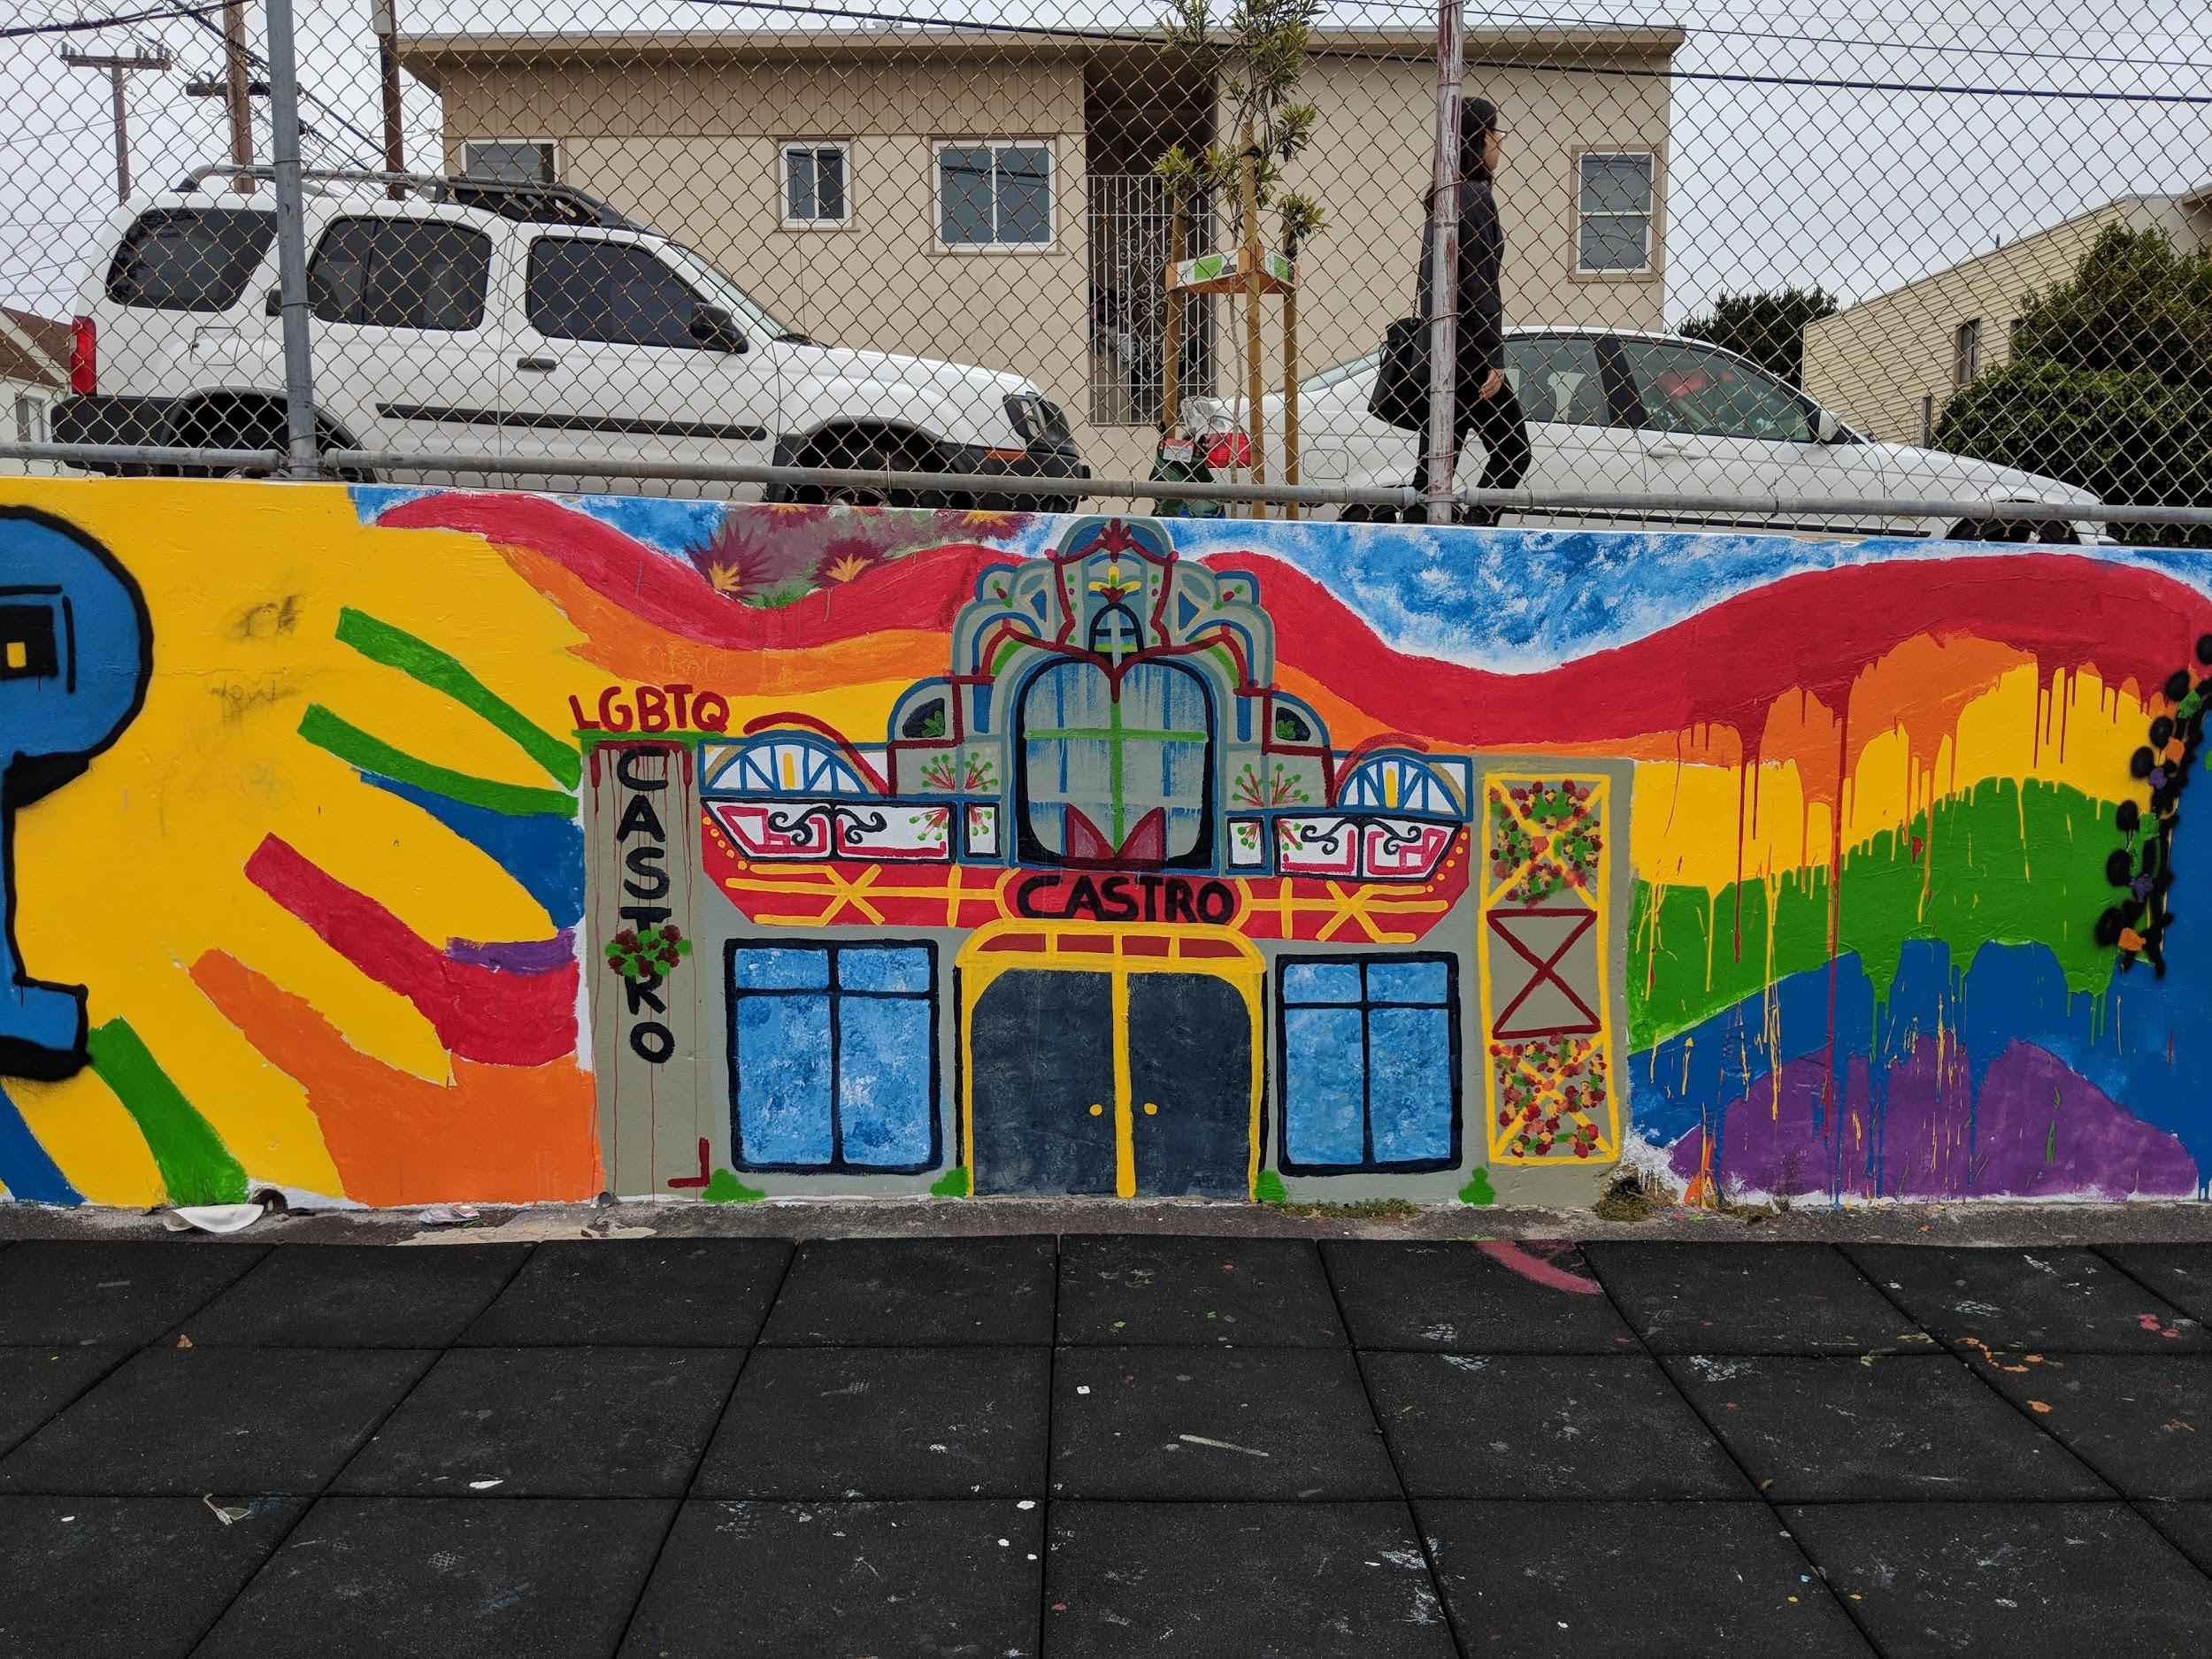
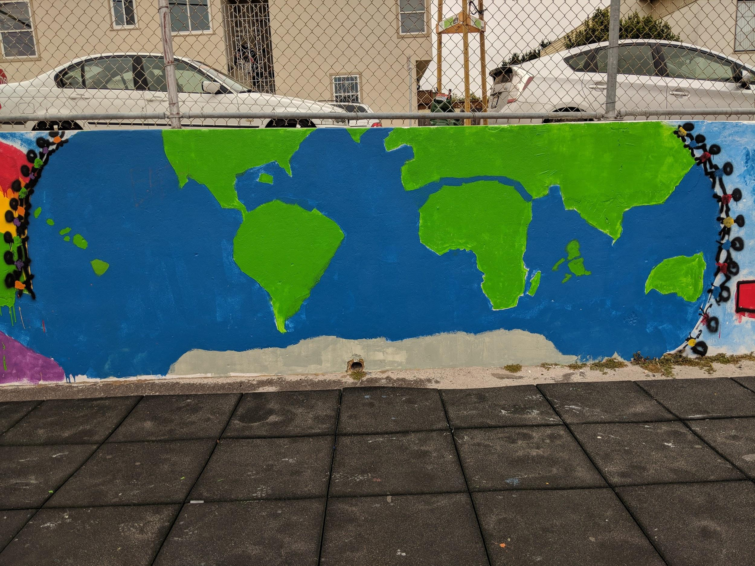
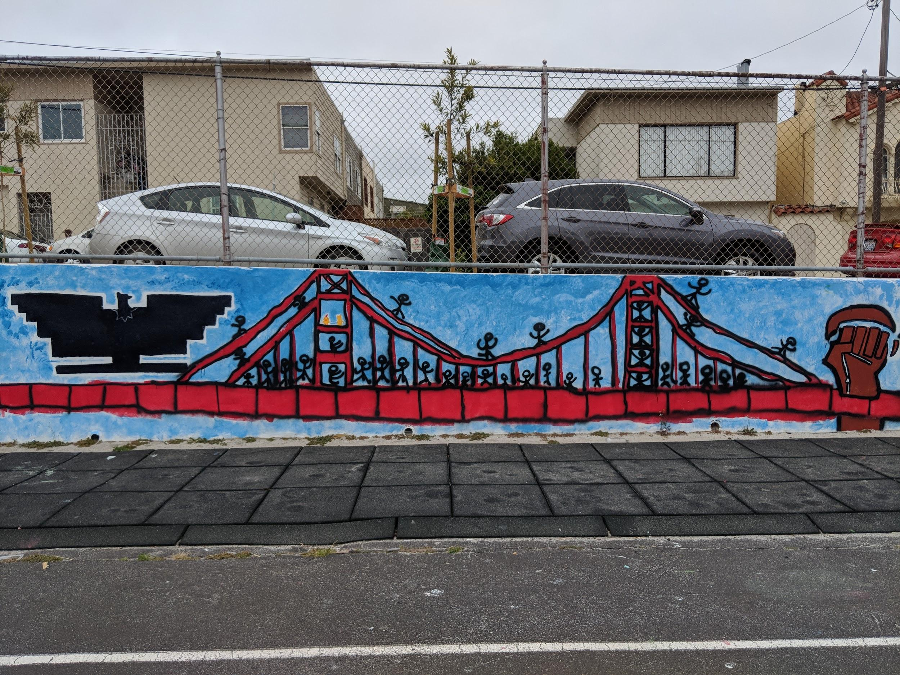
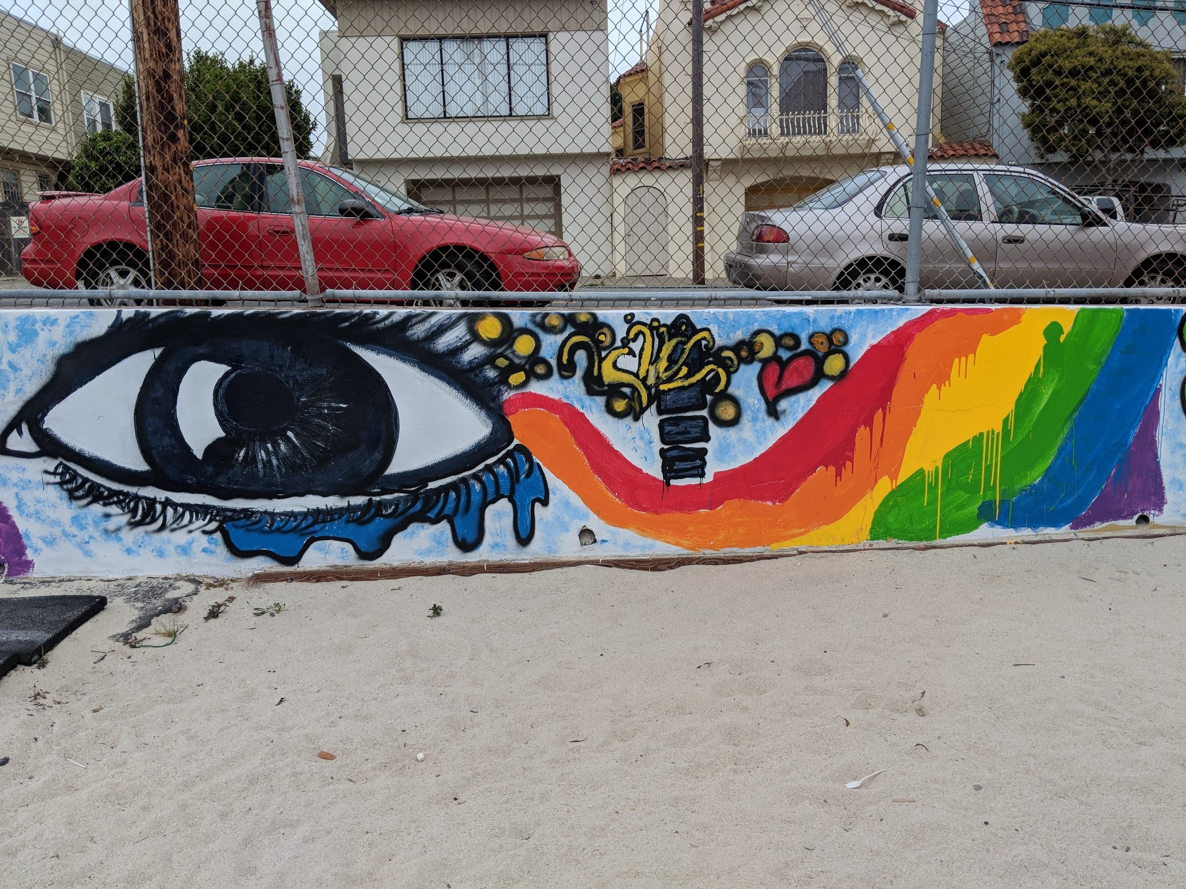
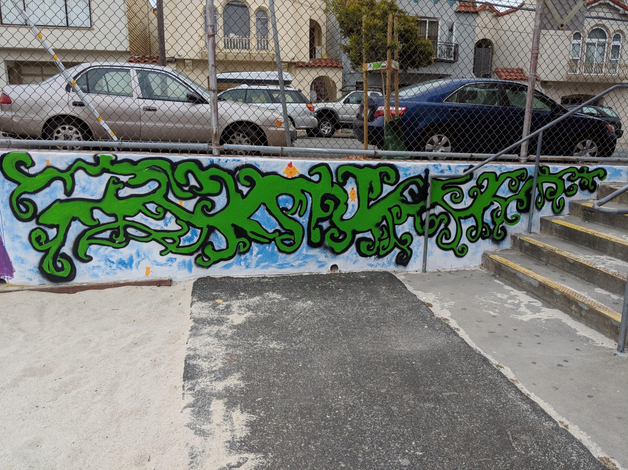

Slide 32
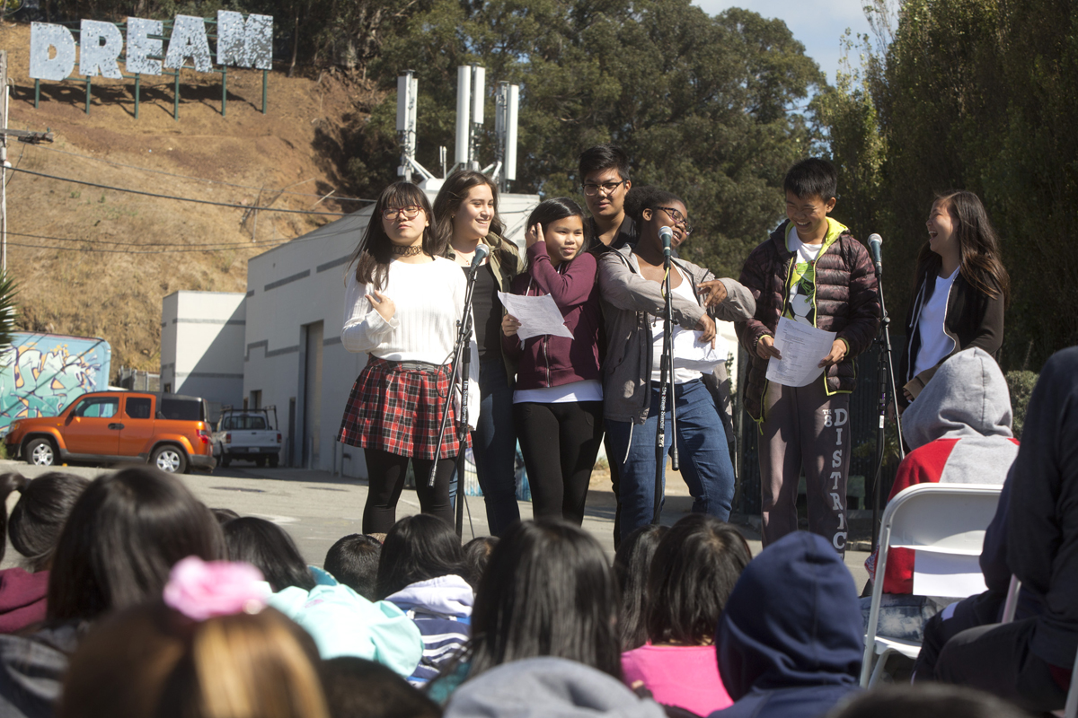

Slide 33
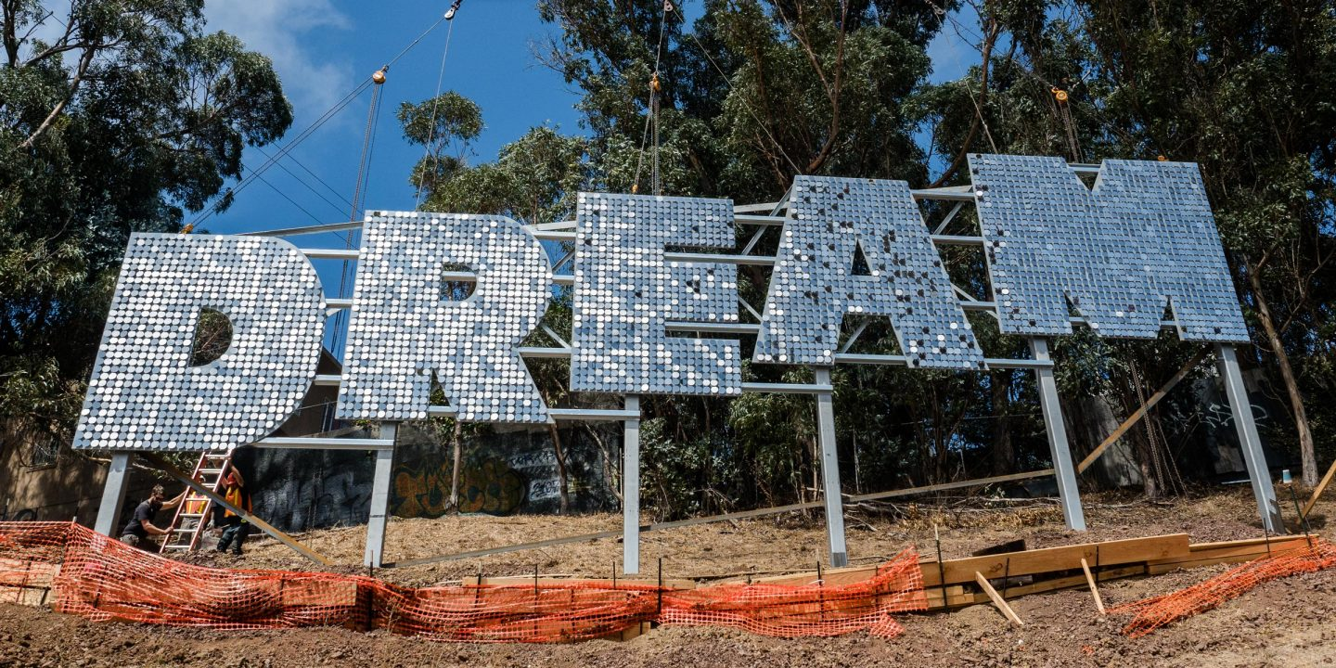

Slide 34
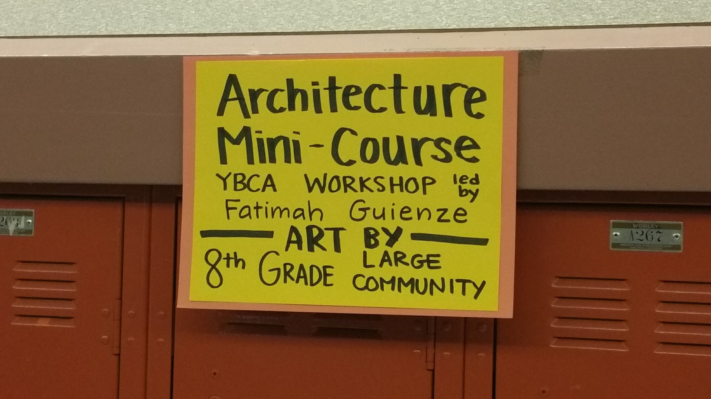
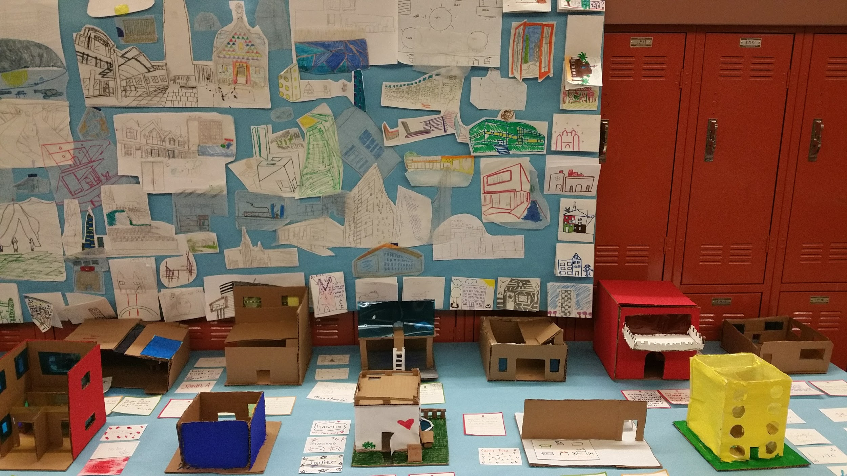
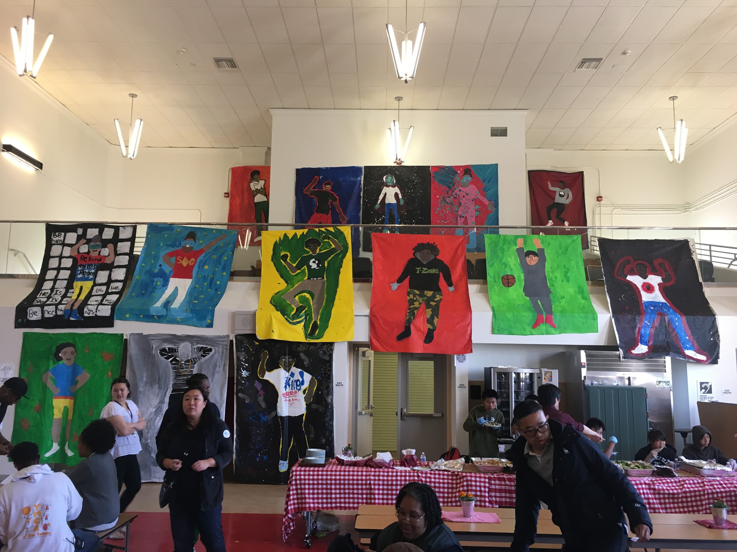
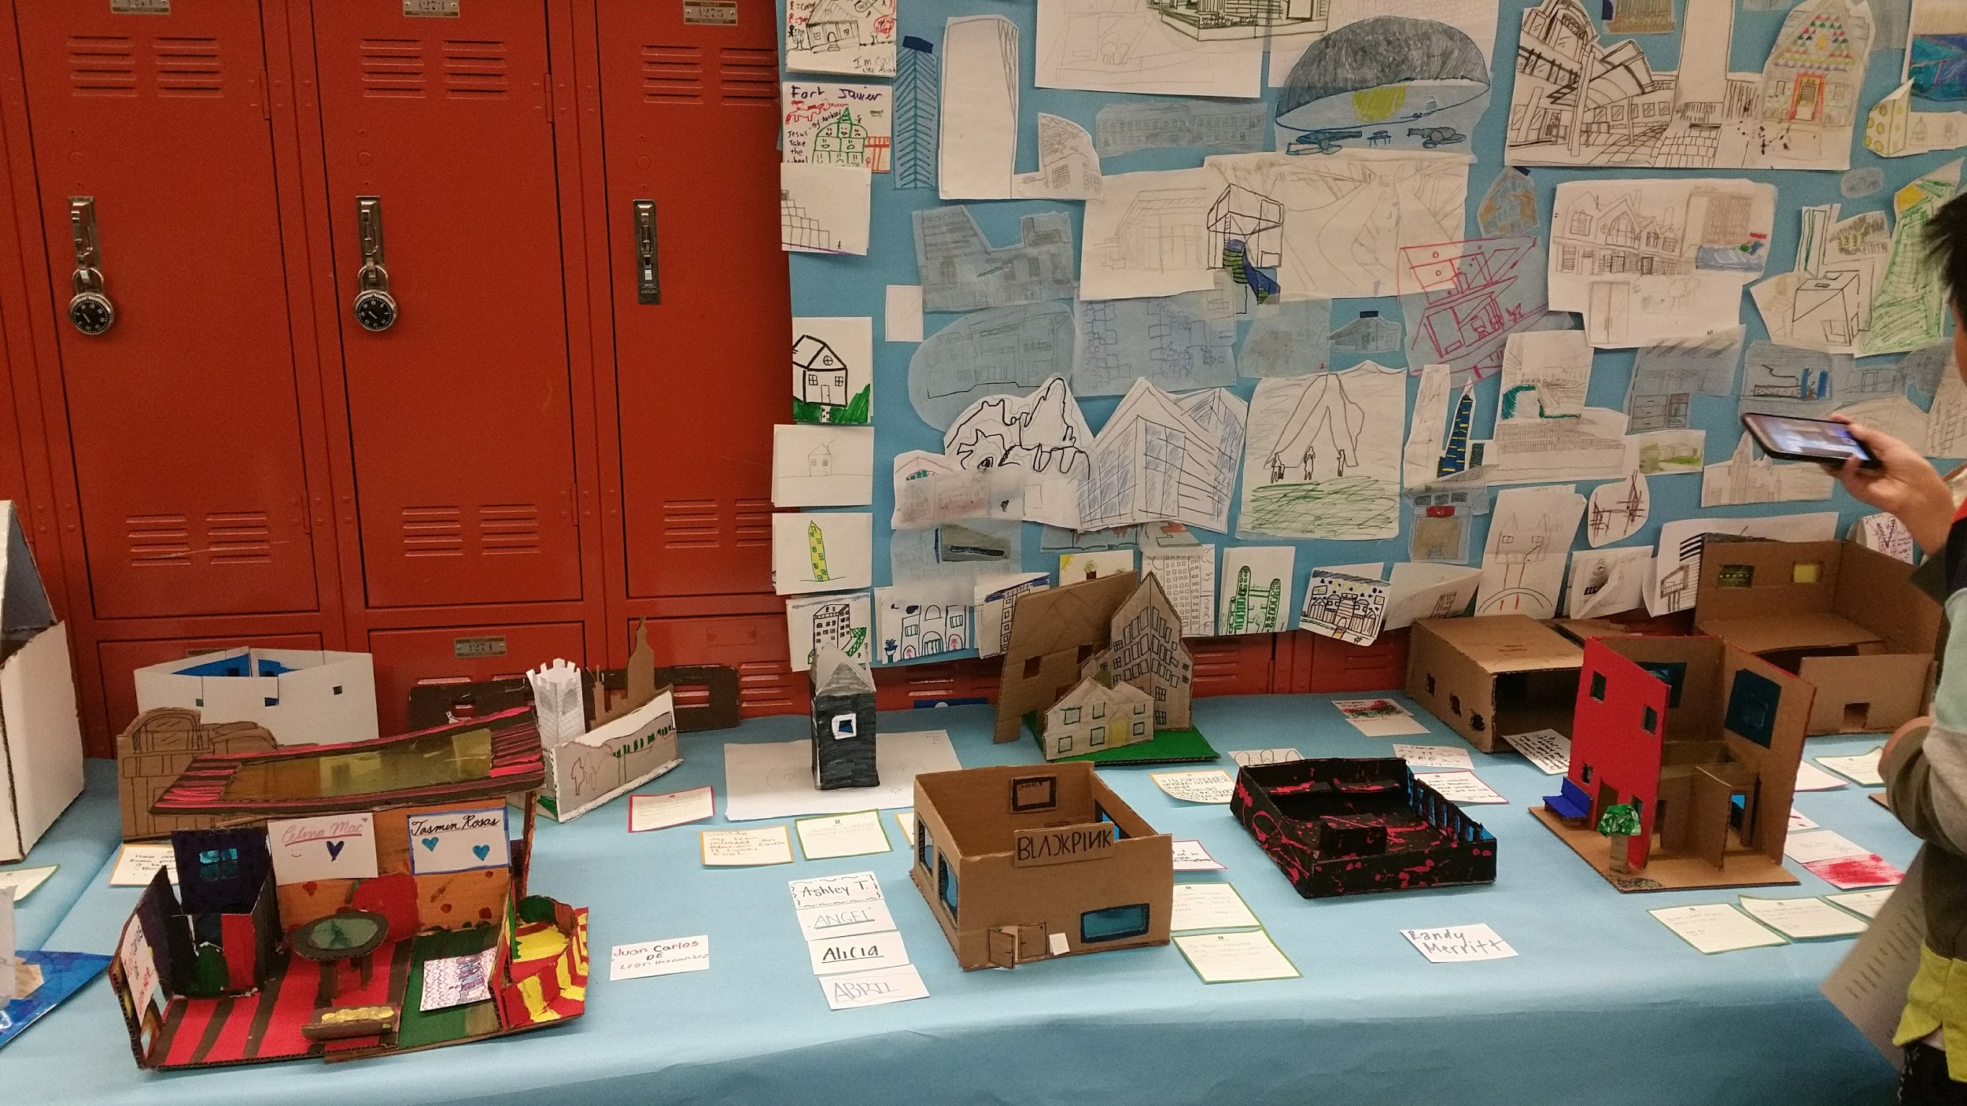
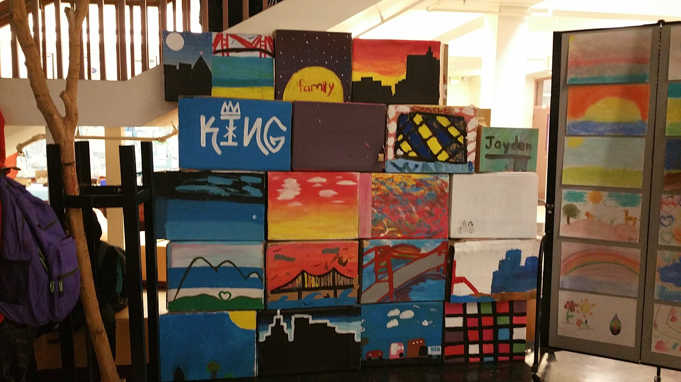
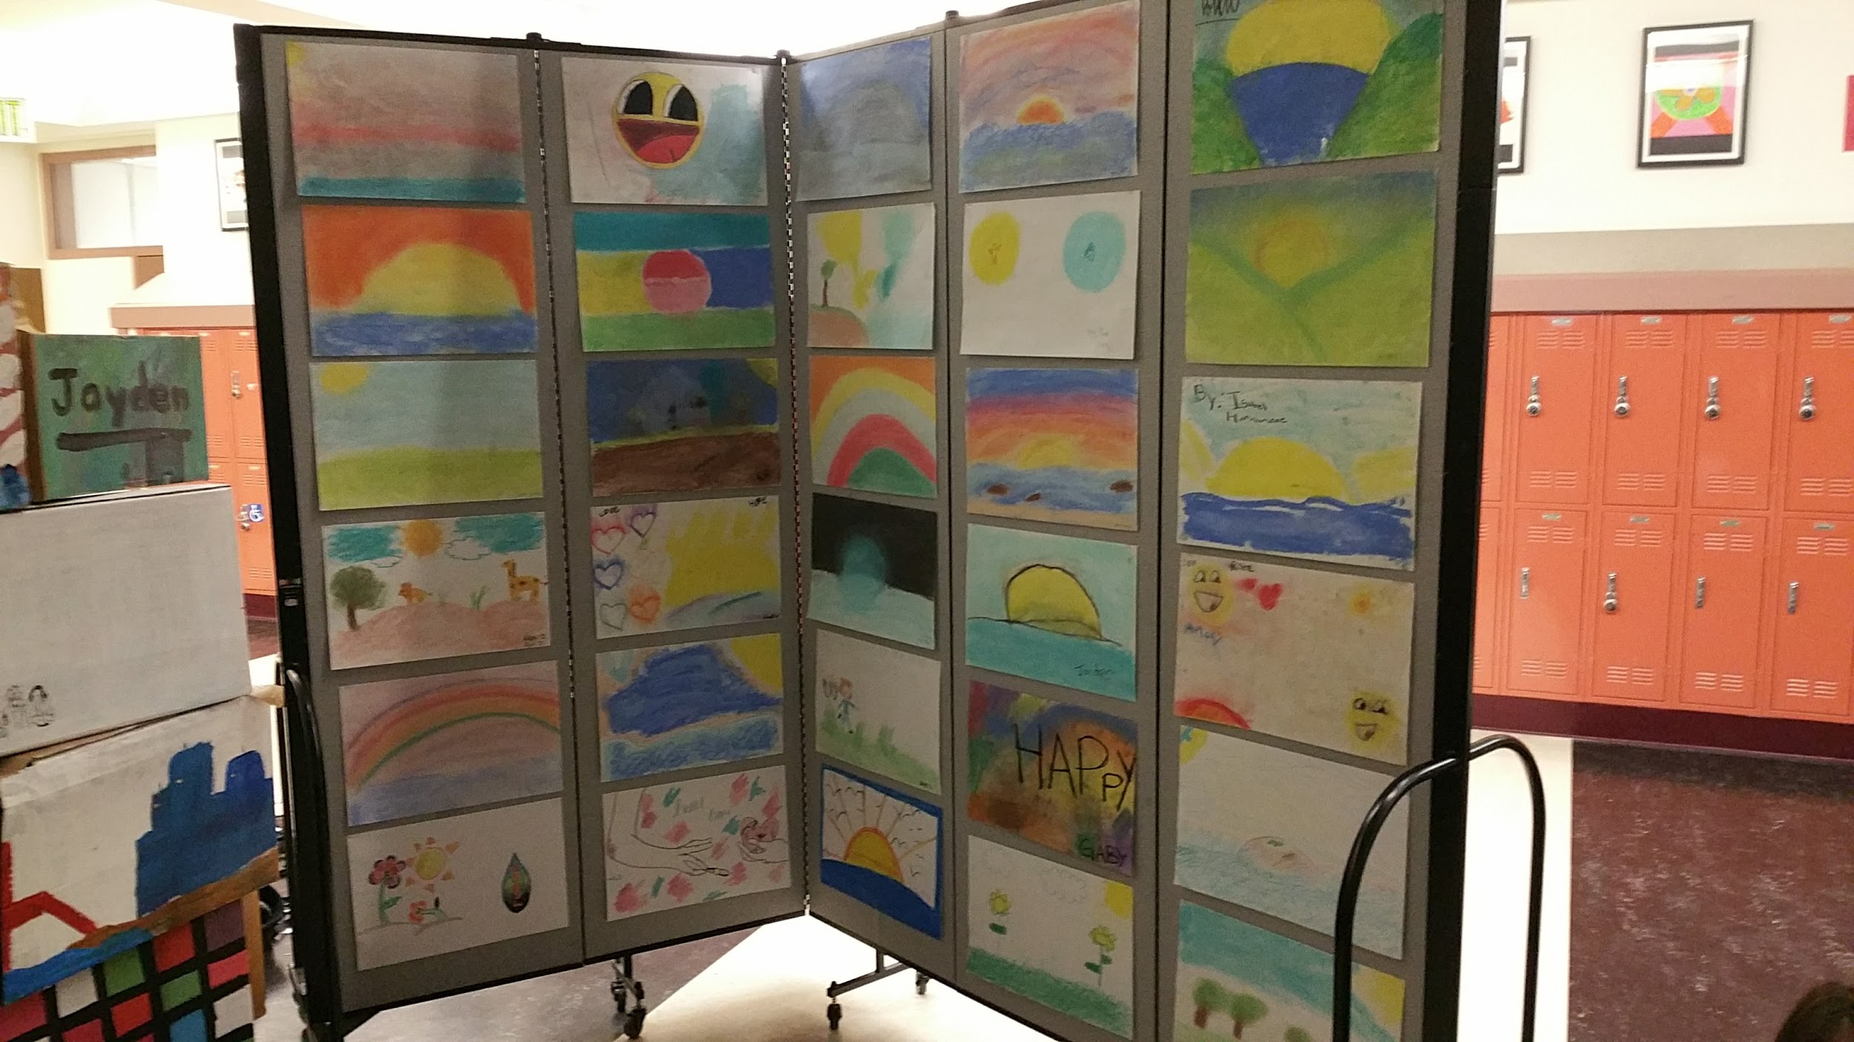

Slide 35
Outcomes

Slide 36
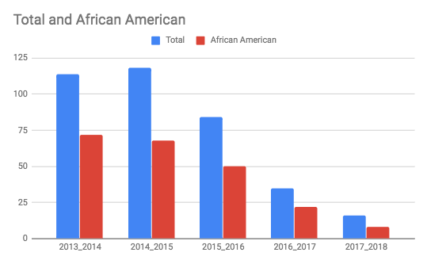
MLK 5-Year Suspension Data: 2013-2018
SEL Whole School Approach
Notes:
Essien Interviewed by the Department of Justice in 2013 due to disproportionality of suspensions and referrals for African American students.
Revisit data from two years at AP and interview of DOJ; restorative practices → power points for students who behave inappropriately

Slide 37
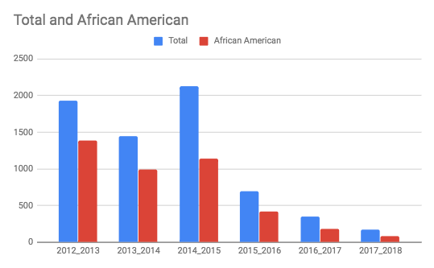
MLK 6-Year Referral Data: 2012-2018
SEL Whole School Approach
Notes:
Essien: vicarious trauma; 3 separate whole-school trainings; push-in services; create opportunities to build student-teacher relationships;

Slide 38
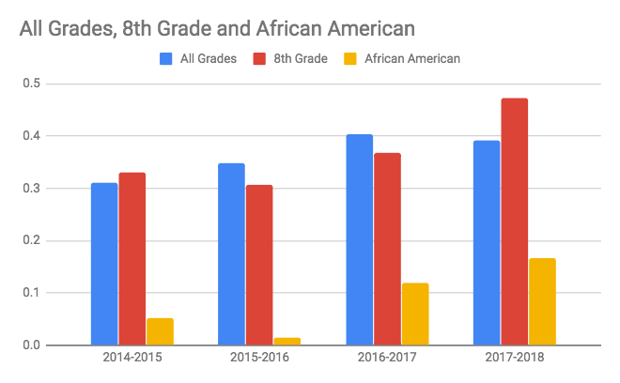
MLK SBAC English Language Arts: 2014 - 2018
uage Arts Assessment
SBAC English Language Arts increased 9%,
7% more than other SF middle schools
23% of 8th graders increased
10% of African Americans
10% gains in each cohort
SEL Whole School Approach
Notes:
Leslie

Slide 39
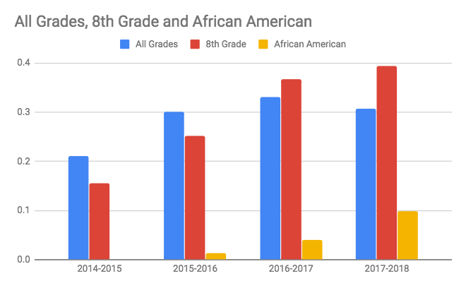
MLK SBAC Math: 2014 - 2018
SBAC MATH increased 9%,
7% more than other SF middle schools
14% of 8th graders increased
11% of African Americans
10% gains in each cohort
SEL Whole School Approach
Notes:
Leslie

Slide 41
Michael Essien, Principal
MLK Middle School
350 Girard Street, San Francisco, CA 94134
Phone: (415) 828-7112
EssienM@sfusd.edu
Follow on Twitter:
@MichaelCEssien
@MLK_MS

