Slide 1
LCFF and LCAPs
Presented to the 4th District PTA
March 18, 2014
Notes:
Introduce Self

Slide 2
Revisiting the Local Control Funding Formula
Greatly simplifies state funding for local educational agencies (LEAs)
ADJUSTMENTS
$
Grade Level
Per Student Base Amount
Demographics (Low income, English Learner, and/or Foster Youth)
2

Slide 3
LCFF Fundamentally Changes California’s Education System

Slide 4
State Board of Education’s LCFF Major Implementation Tasks
2
State Board of Education (SBE) actions to support implementation:
Emergency spending regulations by January 31, 2014
Local Control and Accountability Plan (LCAP) template by March 31, 2014
LCAP evaluation rubric by October 1, 2015

Slide 5
A Plan for LCFF Coherence
4
Regulations | Templates | Rubric
Define Clarify key terms and conditions to support local implementation that achieves LCFF implementation objectives | Organize and Communicate Demonstrate through the development and sharing of the LCAP that local implementation supports LCFF implementation objectives and regulations | Assess and Indicate Assistance Provide a process for assessing performance and identifying assistance based on review of the LCAP that meets specific areas of need related to LCFF implementation objectives and regulations
Connecting Elements/Guiding Principles Performance-focused – relationship between plans, funding use, and outcomes for students Simplicity and transparency Student-focused – local identification of needs, provides equitable opportunity State priorities – define metrics, but rely on local determination of measurement Stakeholder Engagement – parents, community, educators

Slide 6
Adopted LCFF Spending Regulations
6
Calculation of proportionality percentage
Three data sources – LCFF targets, prior year expenditures, and statewide implementation percentage
Clarification of “districtwide, countywide, charterwide, schoolwide”
Threshold and explanation
Oversight and assignment of assistance by county offices of education for districts

Slide 7
Adopted Local Control and Accountability Plan (LCAP)
9
Encourages telling a story of support, impact, and improvement
Emphasis on good planning, communication, and engagement
Organization:
Stakeholder Engagement
Goals and Progress Indicators
Actions, Services, and Expenditures

Slide 8
State Priorities in the LCAP
Conditions of Learning:
Basics: Teachers appropriately assigned and fully credentialed, student access to standards-aligned instructional materials, and school facilities maintained in good repair (Priority 1)
State Standards: Implementation of state-adopted academic content and performance standards (Priority 2)
Course Access: Student enrollment in a broad course of study (Priority 7)

Slide 9
State Priorities in the LCAP
Pupil Outcomes:
Pupil Achievement: Student performance on standardized assessments, college and career readiness, English learner reclassification, AP assessments, etc. (Priority 4)
Other Pupil Outcomes: Outcomes for students in other subject areas. (Priority 8)
Notes:
Next is Pupil Outcomes…

Slide 10
State Priorities in the LCAP
Engagement:
Parent Involvement: Efforts to seek parent input in decision making, promotion of parent participation in programs for unduplicated pupils and special needs subgroups. (Priority 3)
Pupil Engagement: School attendance rates, chronic absenteeism rates, middle school dropout rates, high school dropout rates, high school graduation rates. (Priority 5)
School Climate: Pupil suspension and expulsion rates, other local measures including surveys of pupils, parents, and teachers on the sense of safety and school connectedness. (Priority 6)

Slide 11
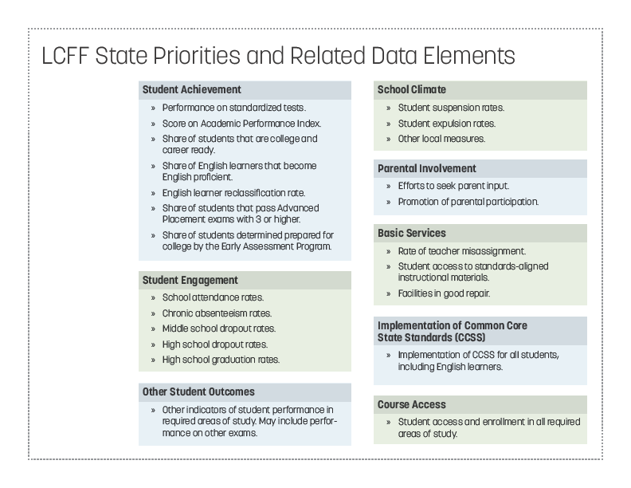

Slide 12
LCAP Section 1: Stakeholder Engagement
Describe in the LCAP the process used to engage the community, including meeting requirements of statute, in developing the LCAP.
Describe how this engagement contributed to the development of the LCAP.
LEAs must still describe goals and actions around the state priorities of parent involvement and pupil engagement which must be detailed in sections 2 and 3.

Slide 13
LCAP Section 2 and 3: Goals and Progress Indicators
Set goals (annual and long term) around state and local priorities
Identify metrics for measuring progress towards goals
Review past progress and adjust if necessary
LEAs must create goals for all school sites and subgroups identified in Education Code Section 52052, but may group and describe these goals together as appropriate.

Slide 14
LCAP Section 3 (A) and (B): Actions, Services, and Expenditures
Identify actions and services to support the goals
Identify expenditures to support the actions and services and describe where these expenditures are included in the LEA’s budget
Review past progress and adjust if necessary
Section (A) requires that actions, services, and expenditures be identified for all students.
Section (B) requires that actions, services, and expenditures be identified for English learners, low income pupils, foster youth, and redesignated fluent English proficient pupils that are beyond what is provided for all pupils.

Slide 15
LCAP Section 3 (C) and (D): Actions, Services, and Expenditures
Section 3 (C) and (D) are where the LEA specifically describes how it is meeting the requirements of the regulations (5 CCR 15496)
Section (C) requires the LEA describe the amount of supplemental and concentration funds estimated for the LCAP year, describe how they are expending the funds, and for those funds they are using in a districtwide, schoolwide, countywide, or charterwide manner, provide the explanations required by the regulations (5 CCR 15496(b)).
Section (D) requires the LEA to describe how they calculated their proportionality percentage and how they are increasing or improving services for unduplicated students above what they are doing for all students by this percentage. (5 CCR 15496(a)

Slide 16
Implementation of LCFF
10
Local educational agencies will develop budgets and plans in 2014-15 reflecting LCFF funding and structures
Spending regulations will guide expenditure planning
LCAP will share story – explain how resources contribute to goals, demonstrate equity, and support transparency and simplicity
Governor’s Budget substantially builds on LCFF implementation

Slide 17
Additional Information
LCFF Basics, Text of Regulations, and Downloadable, Editable LCAP Template
http://www.cde.ca.gov/fg/aa/lc/
Additional Information, LCFF Channel Videos, etc.
lcff.wested.org
Elisa Wynne Ewynne@cde.ca.gov

